Slide 1
NAECA III Product Launch

Slide 2
NAECA III
National Appliance Energy Conservation Act
  Set minimum efficiency levels for water heaters
    All Water heater manufactures
    Effective date April 16, 2015
We can’t manufacture non-compliant product after April 15, 2015
Anything manufactured prior to April 16, 2015 can be sold indefinitely

Slide 3
NAECA III
For the first time -different criteria was established for the larger storage capacity models – over 55 gallon
  Increase for ≤ 55 gal capacities - relatively modest
  Increase for > 55 gal levels is substantial
    Mandates condensing gas technology
Commercial water heaters are not affected
Gallon Capacity | Current | NAECA III
 | Gas | Gas
30 | 0.61 | 0.63
40 | 0.59 | 0.62
50 | 0.58 | 0.60
55 | 0.58 | 0.59
60 | 0.56 | 0.75
66 | 0.54 | 0.75
75 | 0.53 | 0.74
80 | 0.52 | 0.74
100 | 0.48 | 0.72

Slide 4
Gas Objective & Scope
Develop a residential gas portfolio to meet the new NAECA III minimum efficiency regulatory requirements
  Product types included in the scope:
    Standard Atmospheric Vent Gas
    ULN Atmospheric Vent
    Mobile Home
    Direct Vent
      Standard & ULN
  Product types excluded
    Models with greater than 55 gallon storage capacities
    Models with gas input above 75,000 Btu’s
    PV & PDV models, as they are well over NAECA minimums

Slide 5
Gas Overview
Gas Product Design
  No special or unique technology changes
    We did make changes to combustion system in many cases
      gas control, burner, baffle & other internal combustion components
  Most cost effective solution
    Add extra foam insulation
    Move to 2” foam cavities
      Exception
        Atmospheric vent 50 gallon tall 40,000 btu input model (1 ½” foam cavity)
        ULN tall models 30, 40 & 50-gallon (1” foam cavity)
    In some cases, we added a field installed blanket
      To 30 & 40 gallon, 1” foam cavity atmospheric vent models
        Tall & Short profiles
      The one exception to the blanket offering
        The 50-gallon 60,000 Btu input model

Slide 6
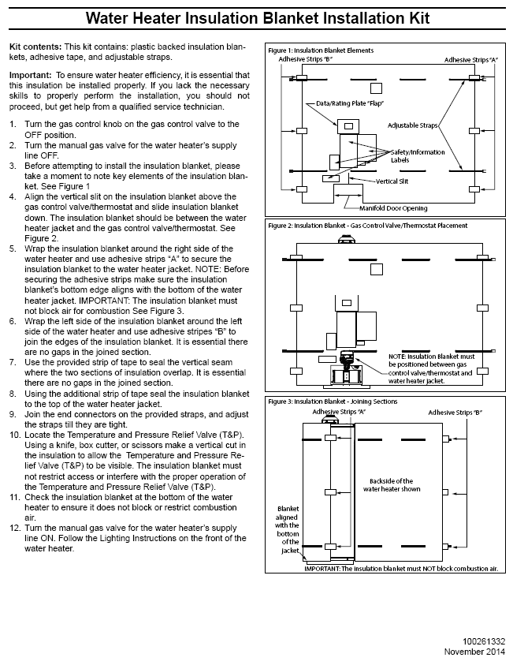
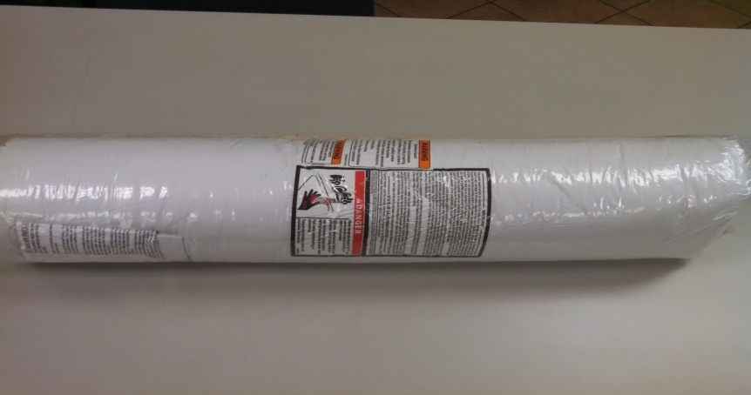
Blankets
Blankets
  Are unique for each model
  Ships loose in corner of carton
    Wrapped in tight roll
  Labels are applied to blanket
    Except rating plate
  Field installed

Slide 7
Tall Gas Models 6/6 & 10/6 Warranty
Gallon Capacity | Current Model | Current Height (Inches) | Current Diameter (Inches) | NAECA-III Model | Height (Inches) | Diameter (Inches)
30 | 30 G 1” | 61 1/2 | 16 | 30 G 2” | 61 3/4 | 18
30 | New 30 gal 1” foam with blanket |  |  | *30 G 1”+ | 61 3/4 | 16
30 | 30 G 2” | 61 1/2 | 18 | 30 G 2” | 61 3/4 | 18
40 | New 40 gal under 40k Btu input |  |  | 40 G 2” | 62 | 20
40 | 40 G 1” | 61 3/4 | 18 | 40 G 2” | 62 | 20
40 | New 40 gal 1” foam with blanket |  |  | *40 G 1”+ | 62 | 18
40 | 40 G 2” | 61 3/4 | 20 | 40 G 2” | 62 | 20
50 | 50 G 1” | 60 3/4 | 20 | 50 G 1 ½” | 60 3/4 | 21
50 | 50 G 2” | 61 | 22 | 50 G 2” | 60 3/4 | 22
* Denotes model with additional external 3” fiberglass insulation blanket.
Dimensions shown do not include the blanket.
Discontinuing the gas Conservationist offering
All brands will have 6 & 10 year warranty models available from the factory, plus a 2 and/or 4-year field warranty extension kits

Slide 8
6/6 & 10/6 Short Gas Models
Gallon Capacity | Current Model | Current Height (Inches) | Current Diameter (Inches) | NAECA-III Model | Height (Inches) | Diameter (Inches)
30 | 30 G 1” | 50 | 18 | 30 G 2” | 50 | 20
30 | New 30 gal 1” foam with blanket |  |  | *30 G 1”+ | 50 | 18
40 | 40 G 1” | 51 1/2 | 20 | 40 G 2” | 51 1/2 | 22
40 | New 40 gal 1” foam with blanket |  |  | *40 G 1”+ | 51 1/2 | 20
40 | 40 G 2” | 51 1/2 | 22 | 40 G 2” | 51 1/2 | 22
50 | 50 G 2” | 53 1/4 | 24 | 50 G 2” | 53 | 24
* Denotes model with additional external 3” fiberglass insulation blanket.
Dimensions shown do not include the blanket.
All blanket models (tall & short) will be Ashland City product design (ring base)

Slide 9
6/6 & 10/6 High BTU Gas Models
Gallon Capacity | Current Model | Current Height (Inches) | Current Diameter (Inches) | NAECA-III Model | Height (Inches) | Diameter (Inches)
40 | 40G-50 | 61 3/4 | 20 | DISCONTINUED
50 | 50G-50 1” | 60 3/4 | 20 | 50G-50 2” | 60 3/4 | 22
50 | 50G-65 2” | 63 7/8 | 22 | *50G-60 2” + | 65 1/2 | 22
55 | Still in design stage |  |  | 55 Gallon 2” | 60 | 24
65 | 65G-65 | 65 | 24 | DISCONTINUED
74 | 75 Gallon | 61 | 26 1/2 | Same N/C | 61 | 26 1/2
98 | 100 Gallon | 68 1/2 | 27 3/4 | Same N/C | 68 1/2 | 27 3/4
* Denotes model with additional external 3” fiberglass insulation blanket.
Dimensions shown do not include the blanket.

Slide 10
6/6 & 10/6 Ultra Low NOx Gas Models
Gallon Capacity | Current Model | Current Height (Inches) | Current Diameter (Inches) | NAECA-III Model | Height (Inches) | Diameter (Inches)
30 | 30G 1” | 59 7/8 | 16 | 30G 1” | 61 3/4 | 16
40 | 40G 1” | 62 1/8 | 18 | 40G 1” | 62 | 18
40 | 40G 2” | 61 7/8 | 20 | 40G 2” | 62 | 20
40 | New 40 gal short |  |  | 40G 2” | 51 1/2 | 22
50 | 50G 1” | 60 7/8 | 20 | 50G 1” | 60 3/4 | 20
50 | 50G 2” | 60 7/8 | 22 | 50G 2” | 60 3/4 | 22
50 | 50G-50 2” | 64 | 22 | 50G-50 2” | 64 | 22
* Denotes model with additional external 3” fiberglass insulation blanket.
Dimensions shown do not include the blanket.

Slide 11
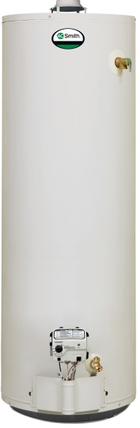
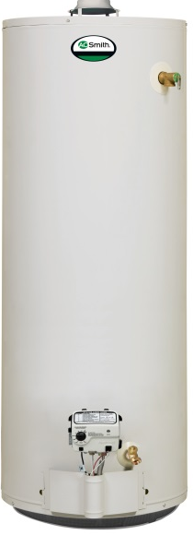
Gas Replacement Options Example
Original 40G 1”
Option 1
New 40 G 2”
Option 2a
New 40 1” + Blk
62”
Tall
62”
Tall
62”
Tall
18”
Dia
20”
Dia
18”*
Dia
1” Foam insulation
2” Foam insulation
1” Foam insulation
+ *External Blanket

Slide 12
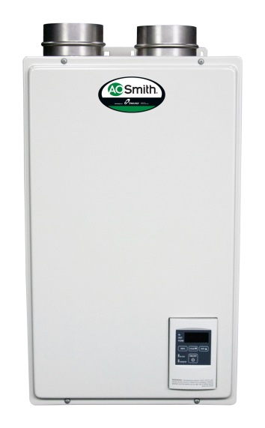
Gas Replacement Options Example
Original 40G 1”
Option 1
New 40 G 2”
Option 2b
Option 3
Tankless
New 30 G 2”
62”
Tall
62”
Tall
62”
Tall
18”
Dia
20”
Dia
1” Foam insulation
18”
Dia
2” Foam insulation
Tankless heater
Retrofit
30 Gallon Tank
+ Mixing Valve
option

Slide 13
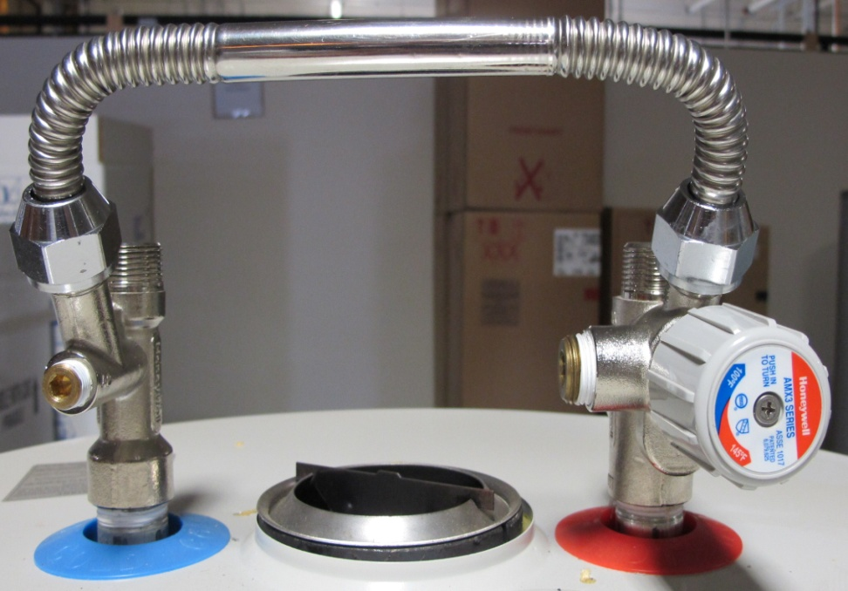
Mixing Valve
Mixing Valve Application
Add on to heater installation
  Doesn’t Improve EF, but can increase 1st hour performance
  Cons
    added installation cost & complexity
  Pros
    More hot water from a smaller tank
    Avoid modifying the space
13

Slide 14
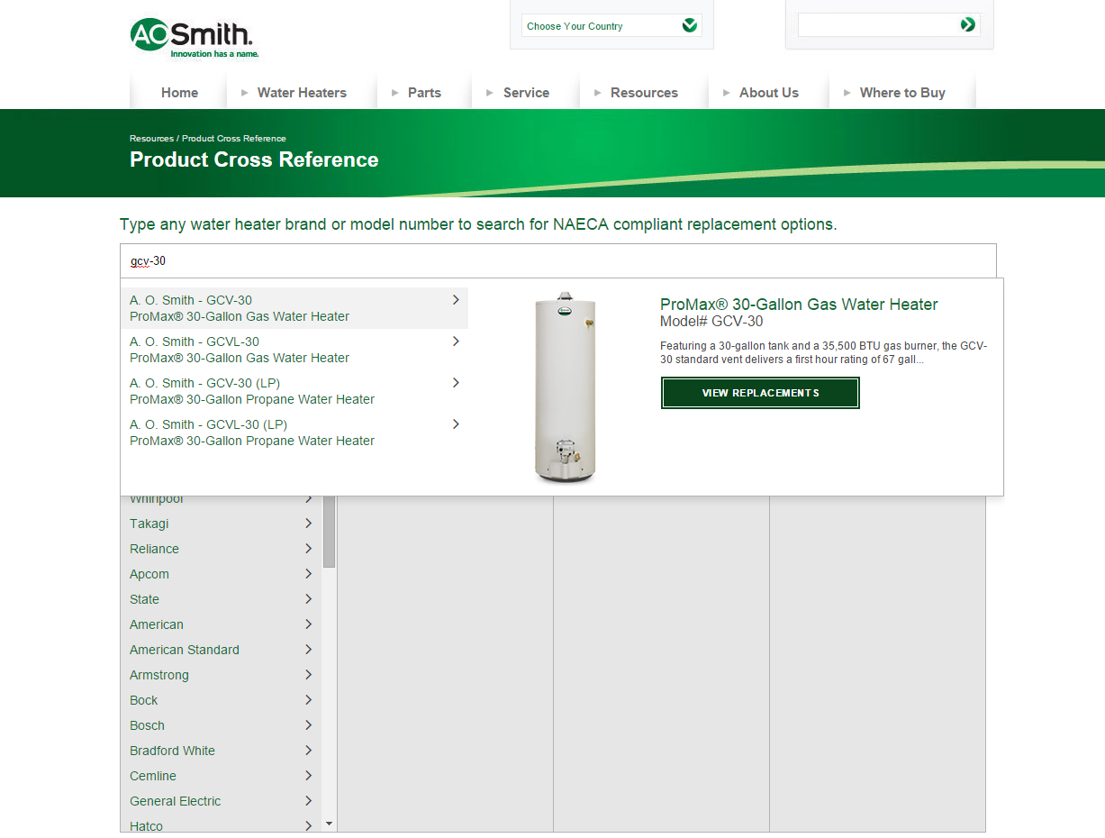
Notes:
A. O. Smith, State and American

Slide 15
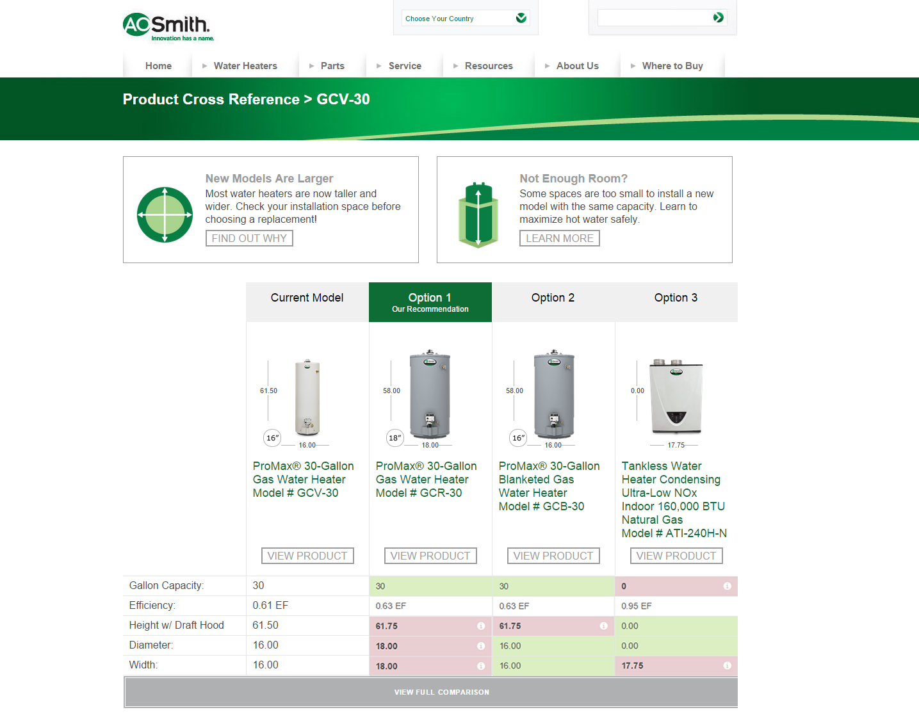
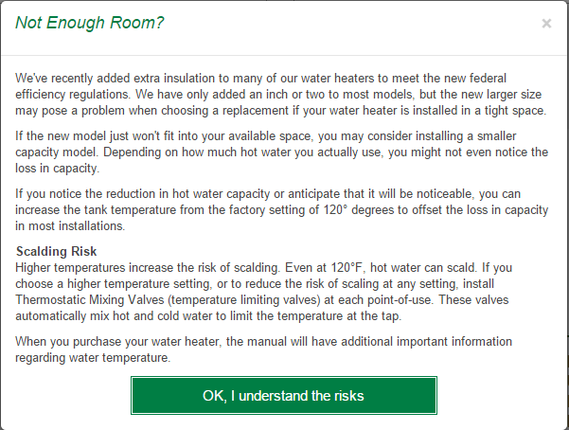

Slide 16

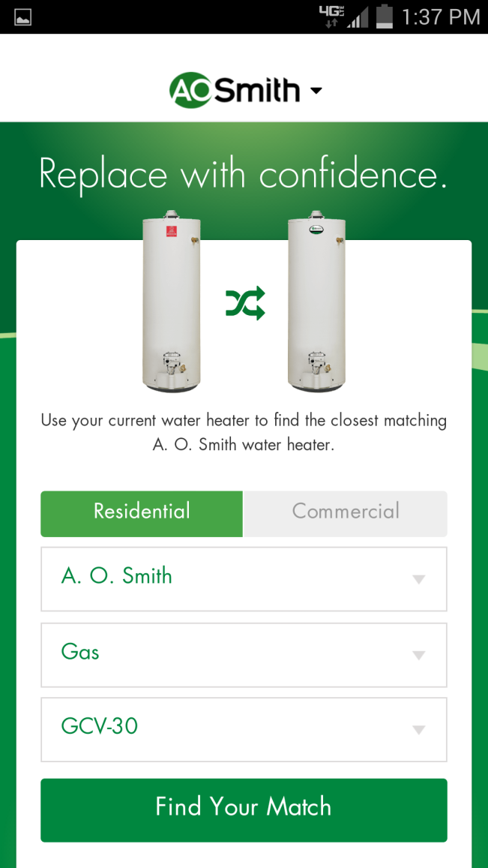
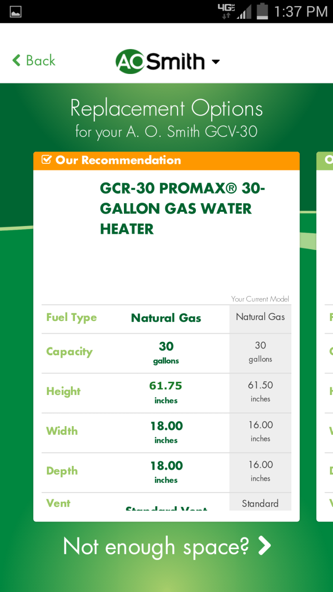
Cross-reference app for iOS and Android
Notes:
A. O. Smith and State
iOS and Android

Slide 17
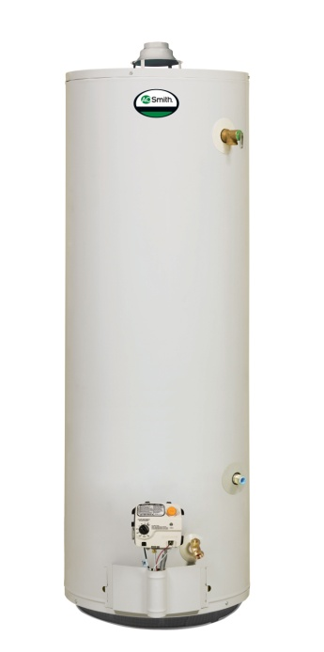
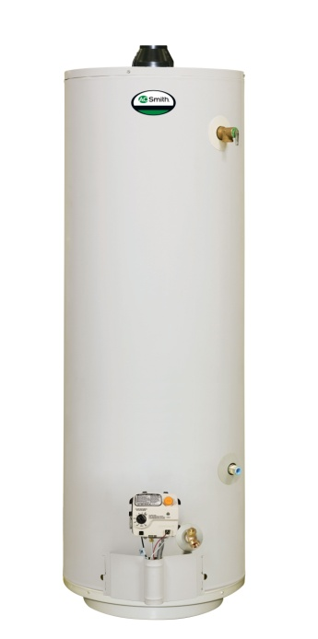
NAECA III Mobile Home
Mobile Home
Atmospheric Vent & Direct Vent (through the floor intake)
  These models will move to a 400 series
  No change to the physical size for State & Smith, only performance increase to meet NAECA

Slide 18
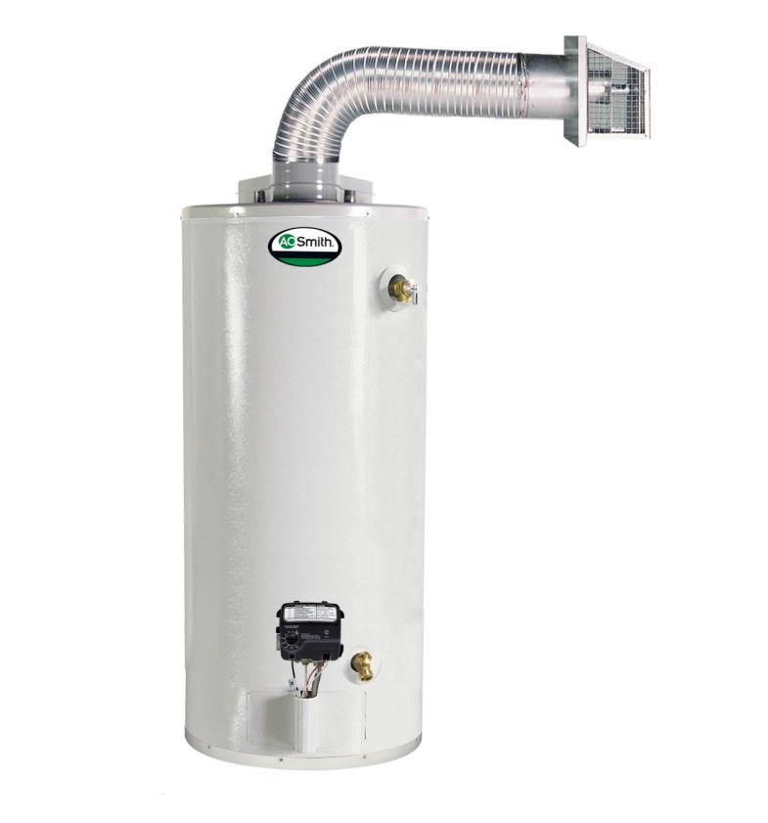
NAECA III Direct Vent
Direct Vent
The DV-75 gallon direct vent model is discontinued for NAECA III
  The current DV offering is a 290/291 series
  The DV family becomes:
    A 40 & 50 gallon standard input
    A 50-gallon high input
      No change to the physical size, only performance increase to meet NAECA
  All move to a 300/301 series

Slide 19
Over 55 Gallon Gas
Discontinued Products in 2015:
- Atmospheric vent Gas 65 Gallon - 65,000 Btu
- Direct Vent 75 Gallon - 55,000 Btu
Products We Keep in 2015:
The 75 & 100 gallon atmospheric vent
The 75 gallon Power Vent
The 75 gallon Power Direct Vent
All 90% efficient models

Slide 20
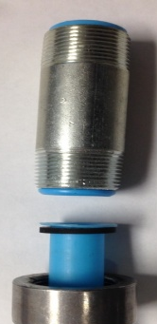

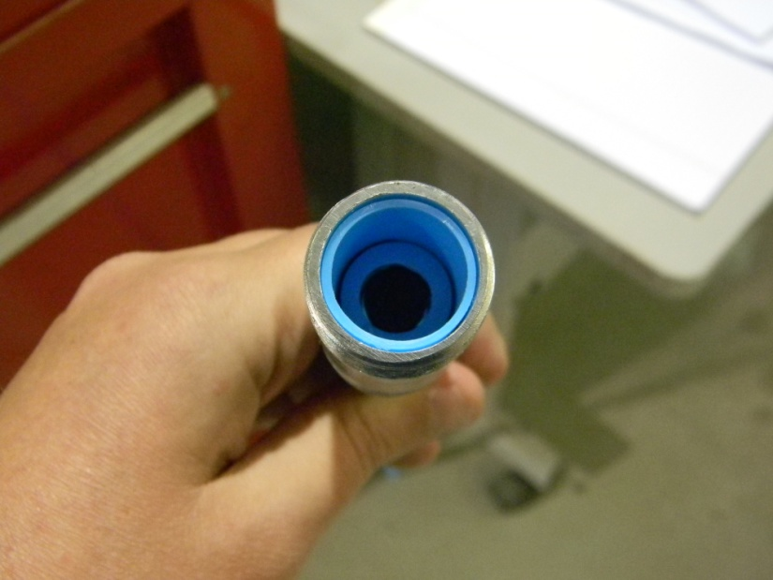
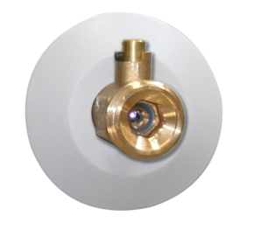
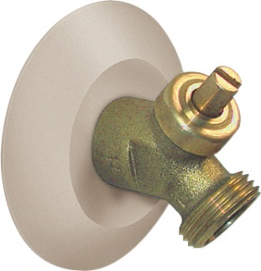
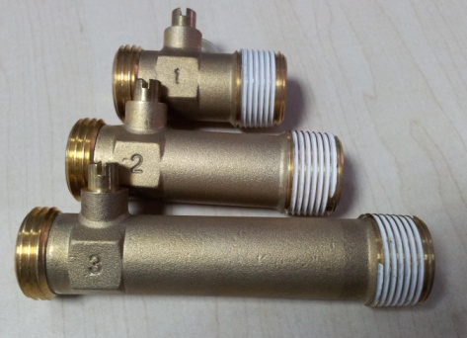
Product Improvements
Minimum inlet gas pressure reduction
  Manifold pressure change from 5”wc to 4”wc
    Except Ultra Low NOx models for California
New natural gas conversion kits
Combination dip tube nipple assembly
  Ensures no cold water bypass
  Installed (heat trap) nipples from the factory
  All models will have a self-cleaning inlet tube
Ported ball type drain valve
  30% more flow for faster draining
  True ¼ turn w/stop
Nipple
Dip Tube
& Gasket
Current System
New Combo Dip Tube

Slide 21
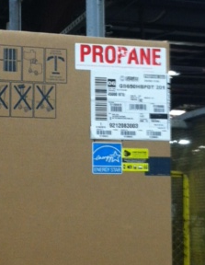
Packaging Identification
Carton Labeling
  No change to the current white corner label
  We will add a green label to the corner of the carton, next to the white corner label
    This label will help identify new NAECA III production
  Will continue to have the large Propane label on the carton for LP gas models

Slide 22

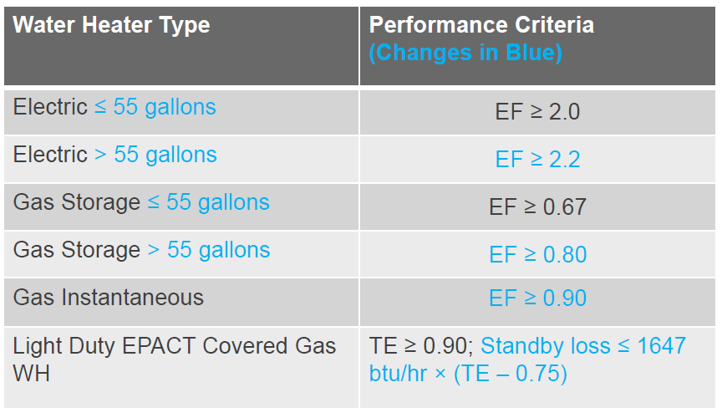
ENERGY STAR 3.0 2015

