Slide 1
NAECA III Product Training
March 2015

Slide 2
NAECA III Requirements
Volume based calculation with new criteria for larger capacity models > 55 gallons
Increase for ≤ 55 gal capacities a challenge for units already very efficient
Increase for > 55 gal levels substantial, requiring technology change to heat pump water heaters
Gallons | Current | April 16, 2015
 | Electric | Electric
30 | 0.93 | 0.95
40 | 0.92 | 0.95
50 | 0.90 | 0.95
55 | 0.90 | 0.94
66 | 0.88 | 1.98
80 | 0.86 | 1.97
120 | 0.81 | 1.92
HPWH
A. O. Smith Confidential – Internal Use Only

Slide 3
Electric Objective & Scope
Develop electric portfolio to meet NAECA III minimum efficiency regulatory requirements including:
Standard electric
Mobile Home
Offer flexible options where feasible
Provide technology upsell
Leverage premium Energy Star qualified heat pump product
Already compliant w/ Energy Star 3.0
Standardize features & design

Slide 4
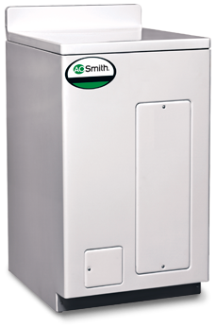
NAECA III Exemptions
Table Top only standard electric model granted exemption because of unique form factor
We are standardizing product design
Compact/Utility <20g not subject to DOE reporting
Solar & storage tanks exempt
Standard 65/66, 80 & 119 gallon models discontinued

Slide 5
Electric Overview
New models 28 through 55 gallons
Achieve EF with increased foam, addition of external insulating blanket
Provide flexibility in models where footprint is issue; lowboy, 50T, 30S
>55 gallon heat pump technology
Broad portfolio w/ 50, 66, & two styles 80 gallon (short or tall)
Energy Star qualified, high First Hour Rating, low sound level

Slide 6
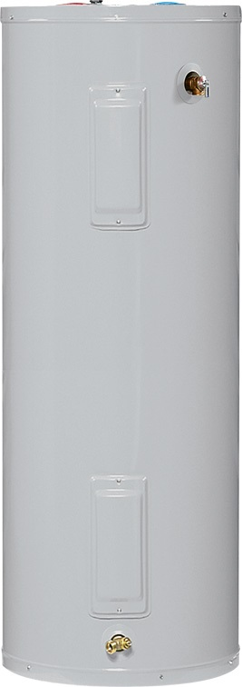
Product Standardization
Electric Standardization changes concurrent with new NAECA III portfolio
Junction box
Nipples installed
Thermostat
Overall (Gas & Electric) feature standardization
Combination dip tube nipple assembly
Ported ball type drain valve
Warranty terms 6/6, 10/6, 10/10
Window Gray paint for jacket/trim

Slide 7
Electric Element Changes
Standard 6/6 & 10/6
Copper upper 4500W element
Incoloy lower 4500W element; resist scale
Premium 10/10
Dual Incoloy 5500W elements; resist scale, faster recovery
Electronic thermostat replaces electromechanical

Slide 8
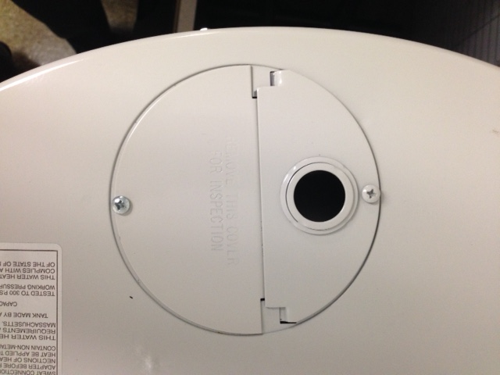
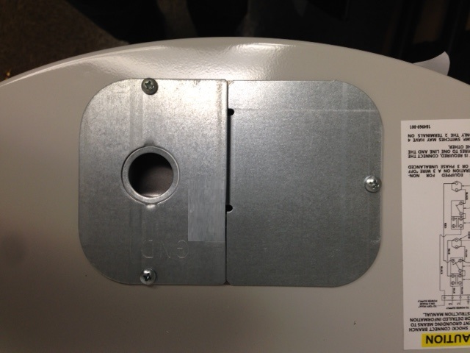
Standardization - Junction Box
Junction box design changes from round/painted to rectangular/galvanized
Internal ground screw
½” & ¾” conduit ready

Slide 9
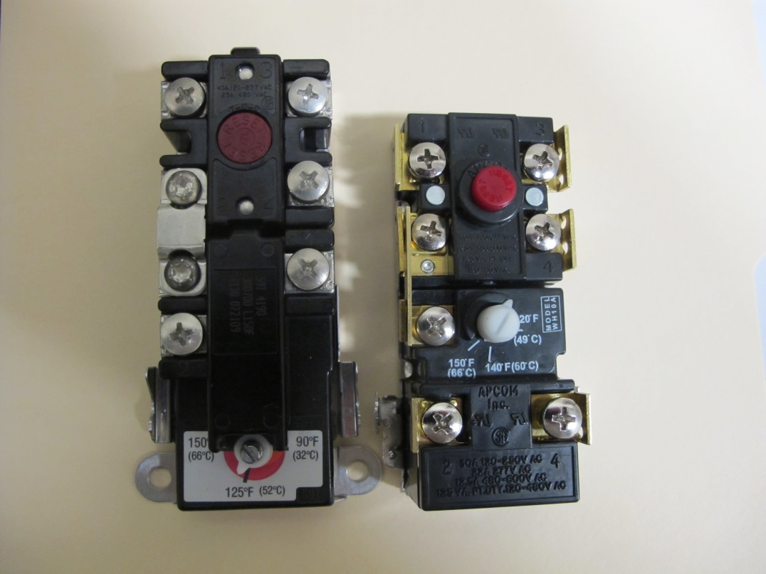
Standardization - Thermostat
APCOM thermostat now standard production on all residential electric
New thermostat bracket
TOD available for service replacements

Slide 10
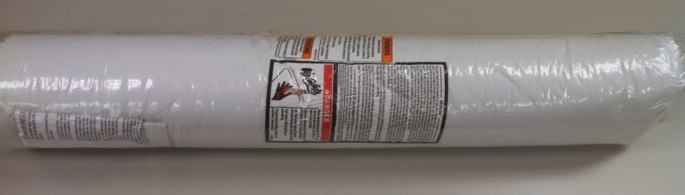
External Insulating Blanket
Ships loose in carton corner
Designed for easy field installation
Vinyl backing
Safety labels
Cutouts for data plate & junction box
For top or side connect
Kit includes instructions & tape
Thickness is 3” fully expanded (optimal insulating capability), may be compressed to ¾” for clearance
Spec sheet dimensions of blanket models listed WITHOUT the blanket

Slide 11
6/6 & 10/6 Tall Electric Models
* Denotes model with additional external 3” fiberglass insulation blanket. Dimensions shown do not include the blanket.

Slide 12
6/6 & 10/6 Short Electric Models
Gallon Capacity | Current Model | Current Height (Inches) | Current Diameter (Inches) | NAECA-III Model | Height (Inches) | Diameter (Inches)
30 | 30 Short/Reg | 36-1/2 | 20-1/2 | 30 Short/Reg | 39-3/4 | 22
30 |  |  |  | 30 Short/Reg Blkt * | 39 | 20
40 | 40 Short/Reg | 44 | 20-1/2 | 40 Short/Reg | 50 | 22
50 | 50 Short/Reg | 48 | 22 | 50 Short/Reg | 49-3/4 | 24
* Denotes model with additional external 3” fiberglass insulation blanket. Dimensions shown do not include the blanket.

Slide 13
6/6 & 10/6 Lowboy Electric Models
LOWBOY TOP CONNECT
Gallon Capacity | Current Model | Current Height (Inches) | Current Diameter (Inches) | NAECA-III Model | Gallon Capacity | Height (Inches) | Diameter (Inches)
30 | 30 Low | 30 | 22 | 30 Low | 28 | 31-1/4 | 24
30 | 30 Low Blkt* | 30 | 20 | 30 Low Blkt* | 28 | 30 | 22
38 | 40 Low | 31-1/4 | 23 | 40 Low | 38 | 31-3/4 | 26
38 | 40 Low Blkt* | 32-1/4 | 24 | 40 Low Blkt* | 38 | 31-3/4 | 24
50 | 50 Low | 34 | 26-1/2 | Discontinued
LOWBOY SIDE CONNECT
Gallon Capacity | Current Model | Current Height (Inches) | Current Diameter (Inches) | NAECA-III Model | Gallon Capacity | Height (Inches) | Diameter (Inches)
30 | 30 Low | 30 | 22 | 30 Low | 28 | 31-1/4 | 24
30 |  |  |  | 30 Low Blkt* | 28 | 30 | 22
38 | 40 Low | 30-1/2 | 23 | 40 Low | 38 | 31-3/4 | 26
38 |  |  |  | 40 Low Blkt* | 38 | 31-3/4 | 24
* Denotes model with additional external 3” fiberglass insulation blanket. Dimensions shown do not include the blanket.

Slide 14
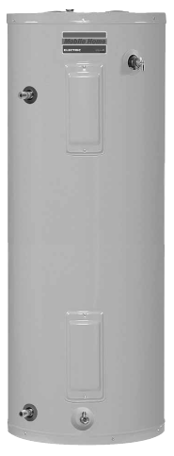
Mobile Home Electric
Today
2015
MODEL | Hgt | Dia
30L | 28 3/4 | 22
30T | 45 | 18
40S/R | 47 1/4 | 20
MODEL | Hgt | Dia
30L * | 30 | 22
30T | 46 3/4 | 19
40S/R | 50 | 22
Side inlet/outlet
Enhanced flow brass drain
Available 240V/3500W or 120V/3000W, copper elements
6 year warranty
* Denotes model with additional external 3” fiberglass insulation blanket. Dimensions shown do not include the blanket.

Slide 15
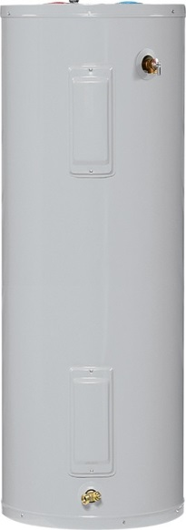
Electric Replacement Options Example
Original 50 Tall
Option 1
New 50 Tall
Option 2
Option 3
New 50 Tall Blkt*
New 40 Tall
54”
Tall
60.5”
Tall
60.25”
Tall
60 1/2”
Tall
20”
Dia
22”
Dia
21”
Dia*
1.75” Foam insulation
20”
Dia
3” Foam insulation
2.5” Foam insulation
+ *External Blanket
40 Gallon Tank
+ Mixing Valve
Field installed

Slide 16
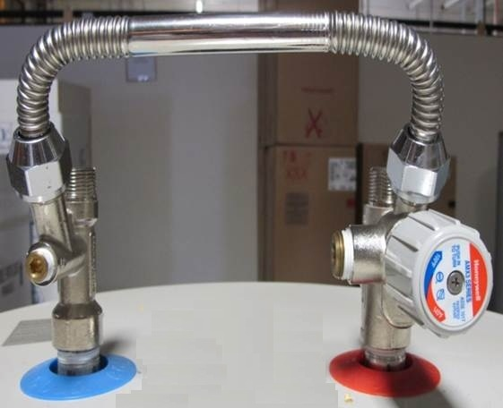
Mixing Valve Application
Works on electric & gas product
Option for multi-dwelling & applications where water heater shares space w/ HVAC air handler
Add on to heater installation
Doesn’t improve EF, but can increase 1st hour performance
Cons - added installation cost & complexity
Pros - more hot water from smaller tank, avoid modifying the space

Slide 17
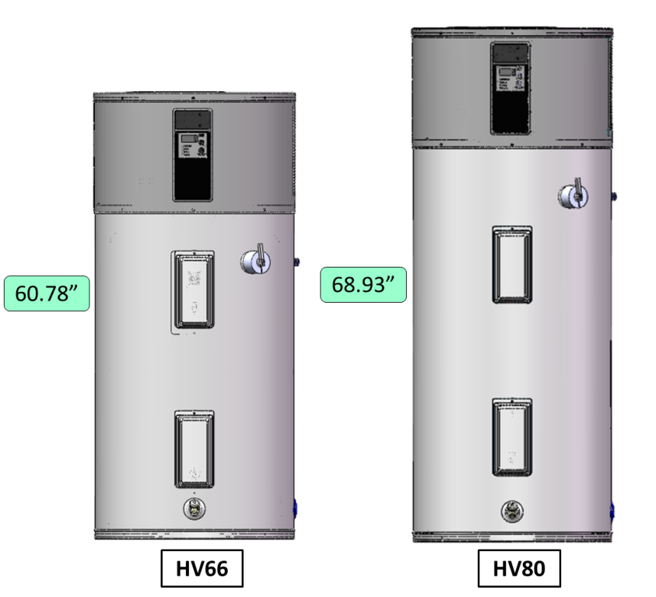
New 66 & 80 Gallon Heat Pump
Low operating cost ~$194
High Energy Factor ~2.72
Superior hot water availability meets UPC
66g = 81 gallon
80g = 91 gallon
Quiet operation (51dBa, as w/50 gal)
Meets Energy Star 3.0 now
66g
80g “short”

Slide 18
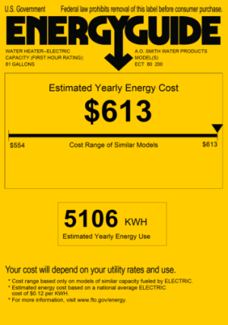
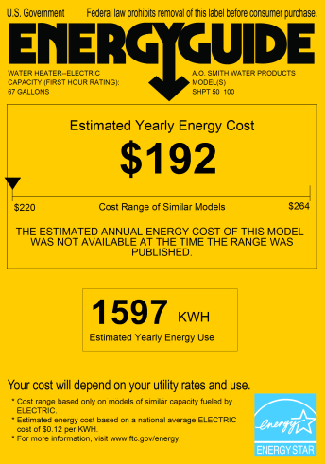
Heat Pump Electric
Today Std. Electric
2015 Heat Pump
Gallon Capacity | Current Model | Current Height (Inches) | Current Diameter (Inches) | NAECA-III Model | Height (Inches) | Diameter (Inches)
50 | 50 Tall | 54 | 20 | 50g HPWH | 63 | 22
66 | 66 Tall | 60 1/4 | 20 1/2 | 66g HPWH | 61 | 27
80 | 80 Tall | 60 1/2 | 22 1/2 | 80g HPWH | 69 | 27
120 | 120 Tall | 64 1/4 | 28 | No model available

Slide 19
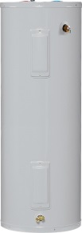
Heat Pump Replacement Options Example
Original 80 Tall
Option 1
New 80g HPWH
Option 2
Option 3
Dual 40 Tall
New 55 Tall
60.5”
Tall
68.5”
Tall
60.33”
Tall
60”
Tall
42”
Wide
22.5”
Dia
26.75”
Dia
1.75” Foam insulation
24”
Dia
Heat Pump
Requires
700 FT³
Open Space
Extra Field
Piping
55 Gallon Tank
+ Mixing Valve
option

Slide 20
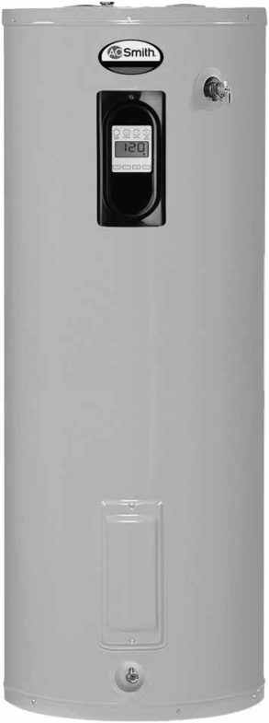
Electronic Models Overview
20

Slide 21
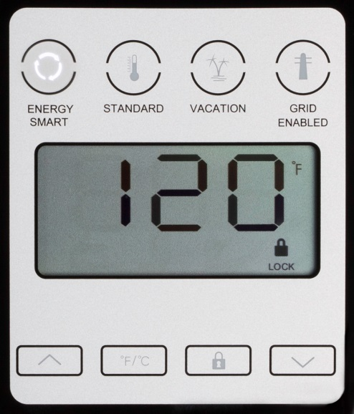
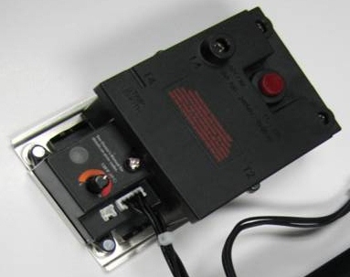
Premium Electric Product Line
Available in 40 & 50 Tall, Short and 55 Tall
Dual Incoloy 5.5KW 240V Elements
10/10/1 warranty
Electronic Thermostat
Grid Management ready
Self Diagnostics
Future remote ready

Slide 22
Electronic Thermostat
More precise temperature sensing
Thermistors more accurate & reliable than conventional thermostats
Dry-fire protection ensures trouble free installation
Diagnostics monitor operational parameters
Ensure reliable operation & hot water availability
Reported on ET via flashing LED (ESM is primary)
No single point of failure – operates with a failed element
Provides connectivity for Smart Grid & home automation connectivity

Slide 23
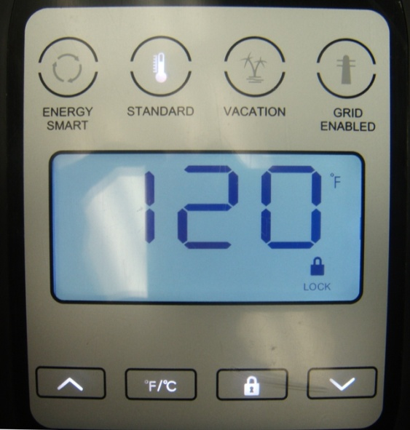
Electronic Thermostat User Interface
Operating Modes; Normal, Saver, Vacation
Energy Saver Algorithm automatically adjusts to consumer hot water use, reducing standby heat loss up to 25%
Vacation mode sets temperature 60° to conserve electricity
User-Friendly Interface integrated in upper element cover
Heads-up digital display
Back-lit buttons for easy operation
Temperature, mode selection in user interface
Icons notify consumer - element on, error code (Alert), unit is under Smart Grid management, or keypad is locked
Access lock feature keeps children from resetting
Diagnostic reporting in LDC
Monitors 1) dry-fire detection, 2) ET failure, 3) lower thermistor failure, 4) upper element failure, 5) lower element failure, 6) ESM defective
mode selection buttons
temperature & lock selection buttons

Slide 24
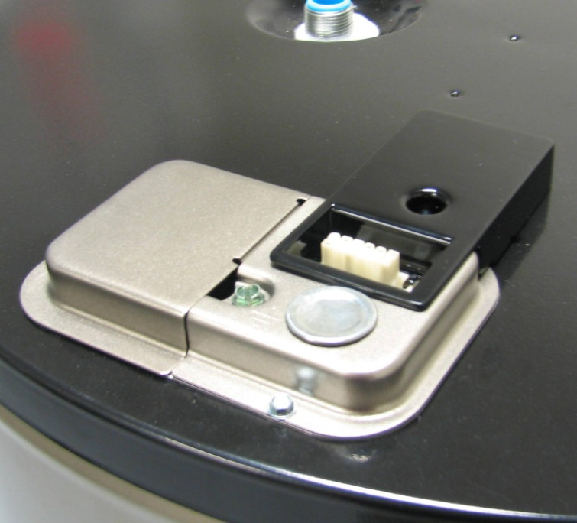
AO Smith SmartPort
SmartPort is a communications port:
Facilitates water heater connectivity to home automation, remote thermostat, utility demand response, & similar connectivity applications
Mounted on top of premium electric models, and on the front of new heat pump models

Slide 25
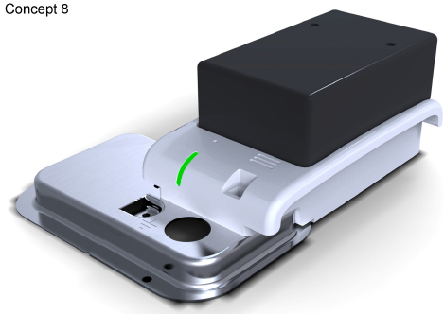
Smart Grid CEA-2045 Bridge Module
Bridge module plugs into SmartPort
Communications module links water heater to utility demand response application(s)
Bridge module features
LED status indicator
Reset button
Audible alarm 85dB
Accessory port
Accessory port options
Leak detection module provides remote notification of leak

Slide 26
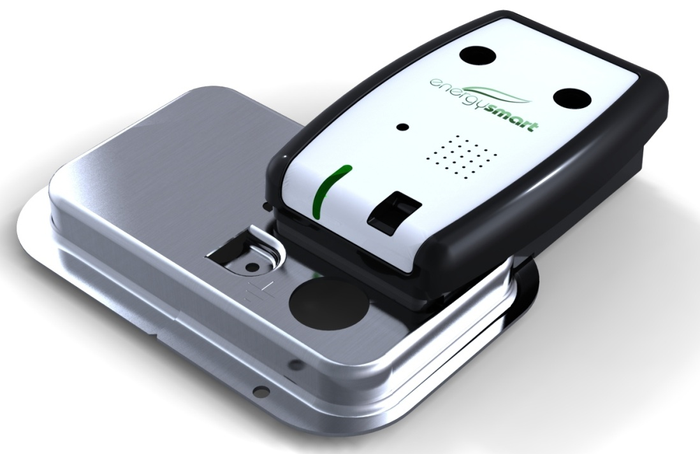
WiFi Controller Capable
Proprietary control module for future home automation application
WiFi connectivity allows remote operation & status monitoring
Plugs into the SmartPort
Plug & play link to homeowner’s internet router
Cloud based application to Smart Phone, Tablet, Pad, or Computer
Features
LED status indicator
Reset button
Audible alarm 85dB
Accessory port
Options
Leak detection module for accessory port will provide remote notification of leak condition

