Slide 1
Texas BTN to BTL Low NOx

Slide 2
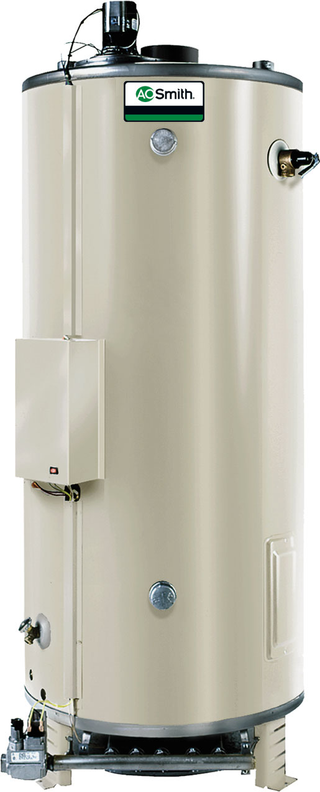
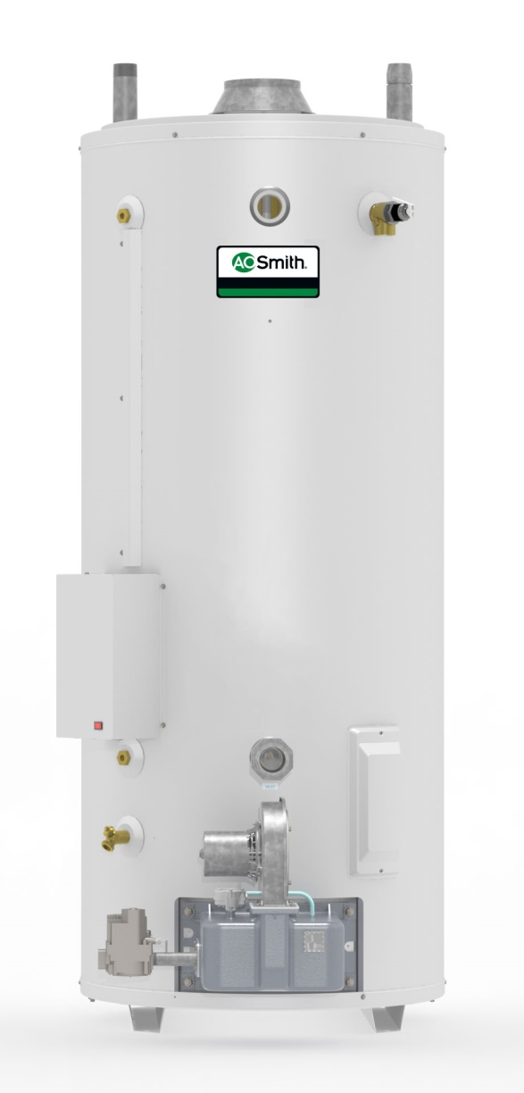
BTN to BTL
BTN Design
BTL Design

Slide 3
Model Number Compare
A. O. Smith
Old BTN | New BTL
BTN-120 | BTL-120
BTN-154 | BTL-154
BTN-180 | BTL-180
N/A | BTL-198
BTN-199 | BTL-199
BTN-200 | N/A
BTN-250 | BTL-250
BTN-275 | BTL-275
BTN-310 | BTL-310
BTN-366 | BTL-366
BTN-400 | BTL-400
BTN-200A | N/A
BTN-250A | BTL-250A
BTN-275A | BTL-275A
BTN-310A | BTL-310A
BTN-366A | BTL-366A
BTN-400A | BTL-400A

Slide 4
Design Comparison
 | BTN Design | BTL Design
Model Range | 120 - 400 | 120 - 400
199K Models | 100 Gallon Only | 80 & 100 Gallon
100/199 Height | 72" | 71-3/4"
100/199 Diameter | 27-3/4" | 27-3/4"
Blower | Top - Pull blower | Bottom - Push blower
Pressure Switch Max Deformation Pressure | 8" W.C. | 14" W.C.
Gas Valve | Honeywell | White Rodgers
Ignitor | Hot Surface | Spark to Pilot
Burner | Swordfish w/bracket | Tube Burner

Slide 5
New BTL Series 200 Design
Key Product Attributes:
Exceeds TX NOx by 200%
80% thermal efficiency
New 80 gallon 199K
No damper design
Designed for reliability
Self cleaning with front inlet
Ultra Coat glassing
Top, Front, Rear water connections

Slide 6
New BCL Series 200 Design
3 tank capacities
10 models
81 Gal: 120, 154, 180, 198
100 Gal: 199, 250, 275
86 Gal: 310, 366, 400

Slide 7
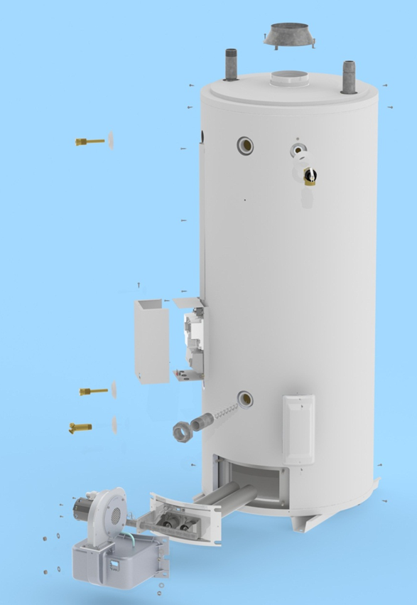
New BTL Series 200 Design

Slide 8
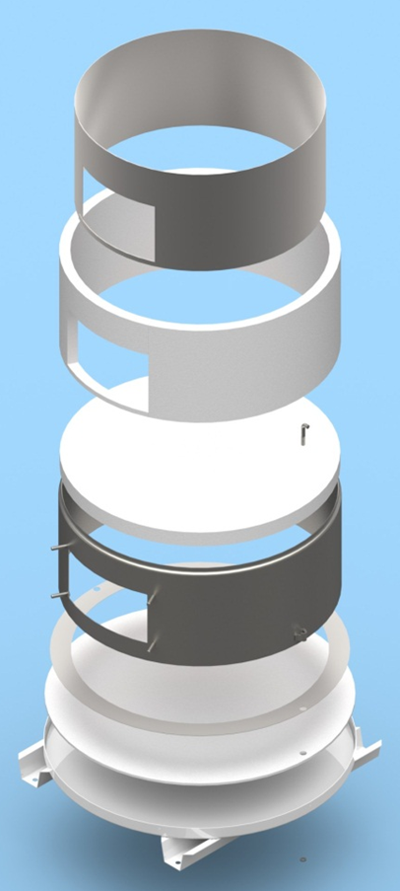
BTL Series 200 Combustion Chamber
.

Slide 9
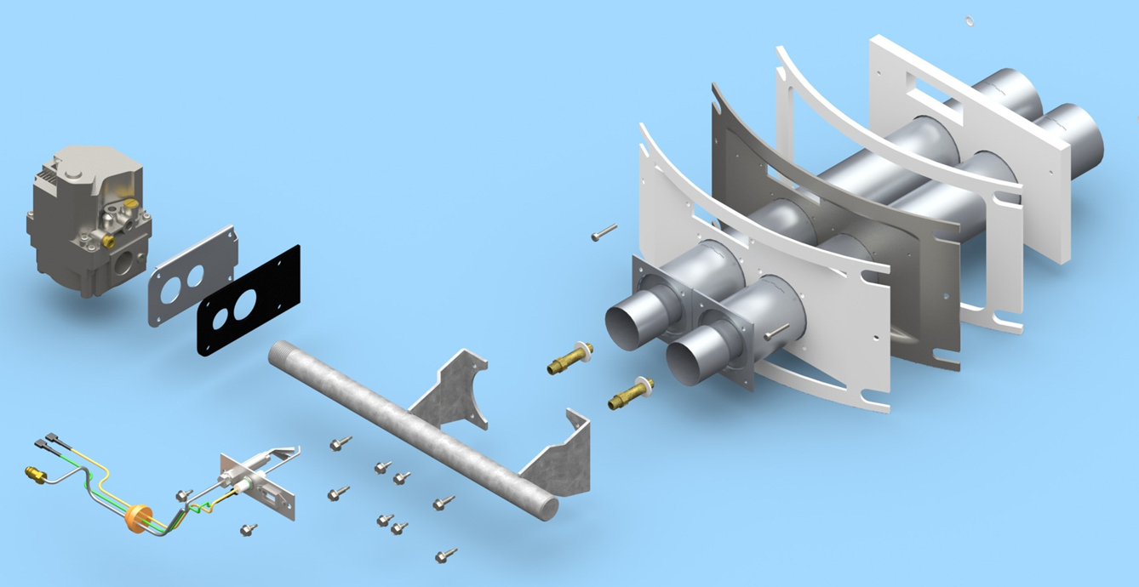
New BTL Series 200 Burner Assembly
.

Slide 10
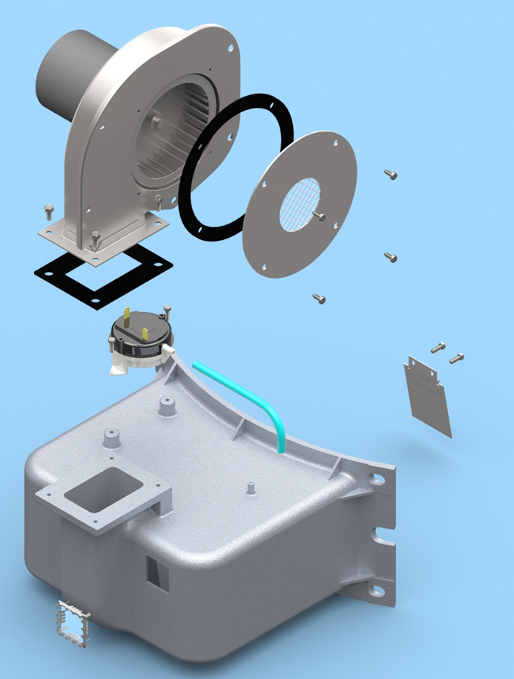
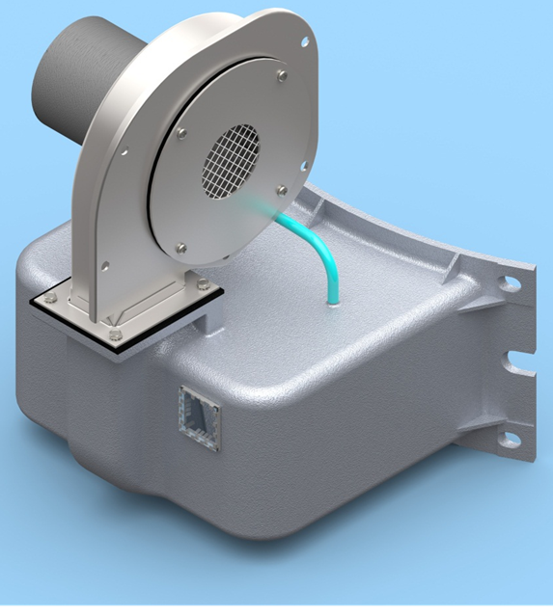
New BTL Series 200 Blower Assembly
.

Slide 11
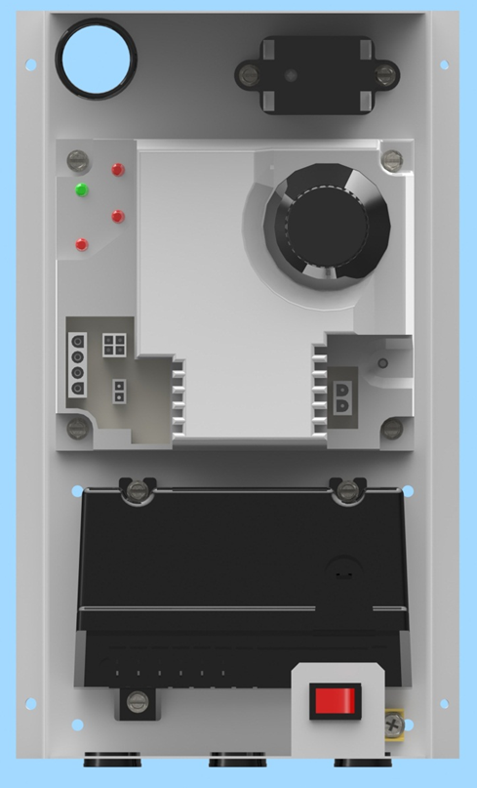
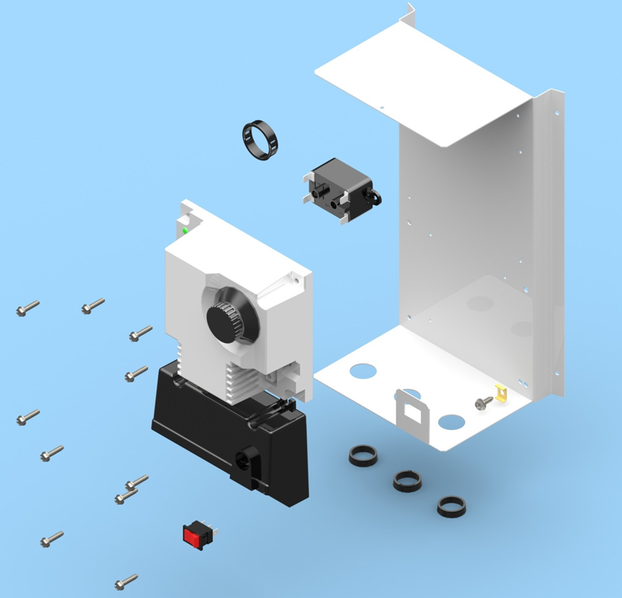
New BTL Series 200 Control Assembly
.

