Slide 1
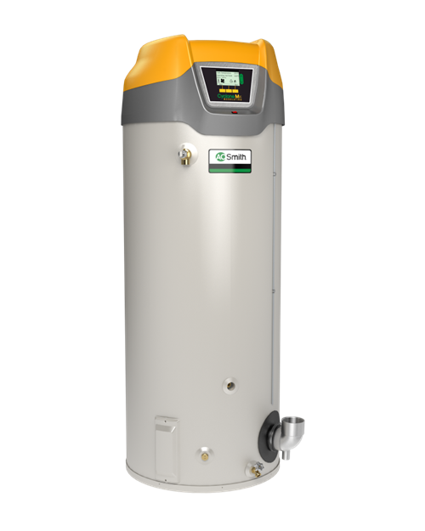
Cyclone Mxi Product Details

Slide 2
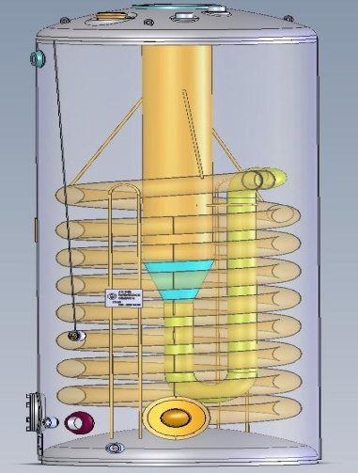
Tank Construction
Exhaust/condensate relocated to front
T&P relocated to left side
Addition of recirculation loop return opening
Larger diameter combustion tube
150 – 250 was 5” now 6”
300 – 500 was 8” now 10” (new 119 gal capacity)
Fire tube cone transition
Additional row of coil

Slide 3
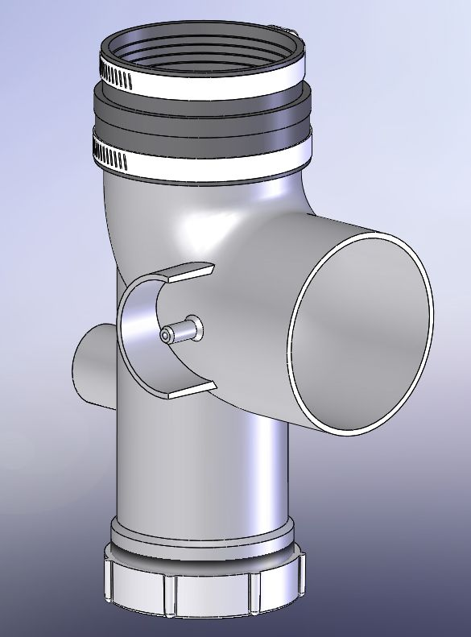
Exhaust/Condensate Elbow
Aluminum Condensate Elbow
Water trap
Debris trap and cleanout
Threaded port for condensate drain
Blocked outlet switch connection

Slide 4
Top Components
Enable/Disable switch
Pressure switches vertically mounted
Pressure switches grouped (from the front)
Blocked outlet with red label
Blocked inlet with aqua label
Blower prover with red label
Honeywell spark module
New design control box
Field wiring junction box

Slide 5
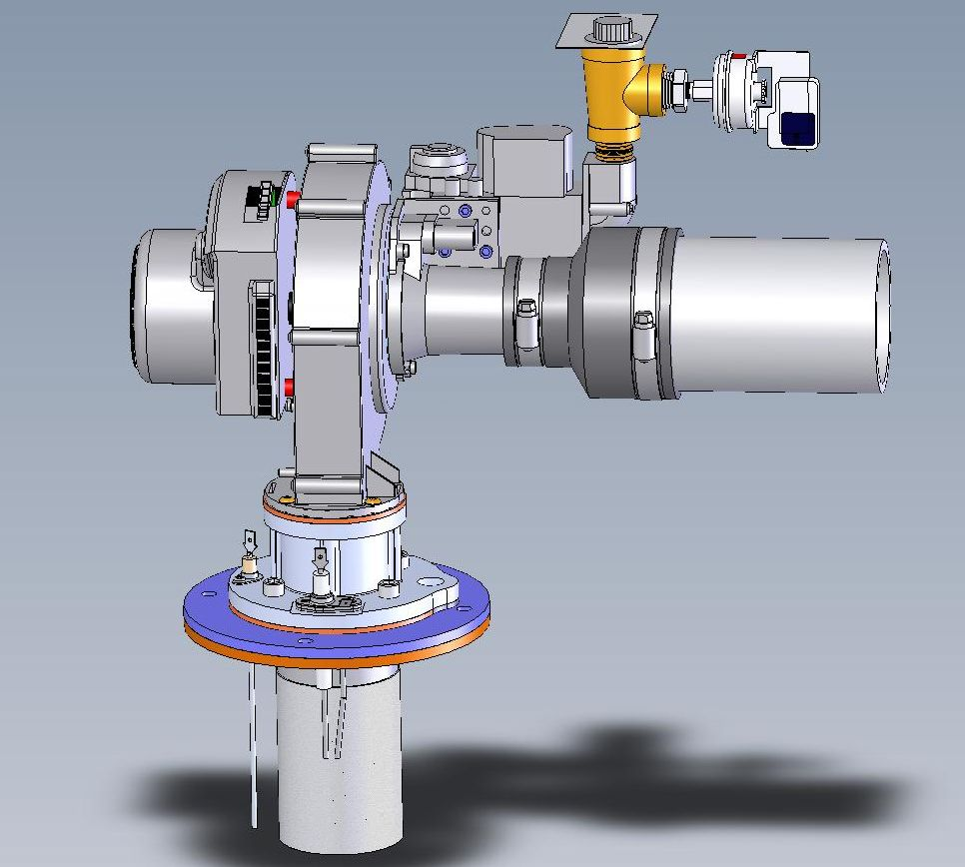
120 Model Combustion System
EBM RG128 Blower
Honeywell VK8115FB Natural Gas Valve/Venturi Assy with 053 Venturi
Honeywell VK8115F LP Gas Valve/Venturi Assy with 003 Venturi
Acunit Burner
Kanthal APM Spark Electrode
.125” Spark Gap (between spark rod and ground rod)
¼” – 5/16” away from burner surface
Kanthal APM Flame Rod
½” away from burner surface
Aluminum Burner/Blower Adaptor

Slide 6
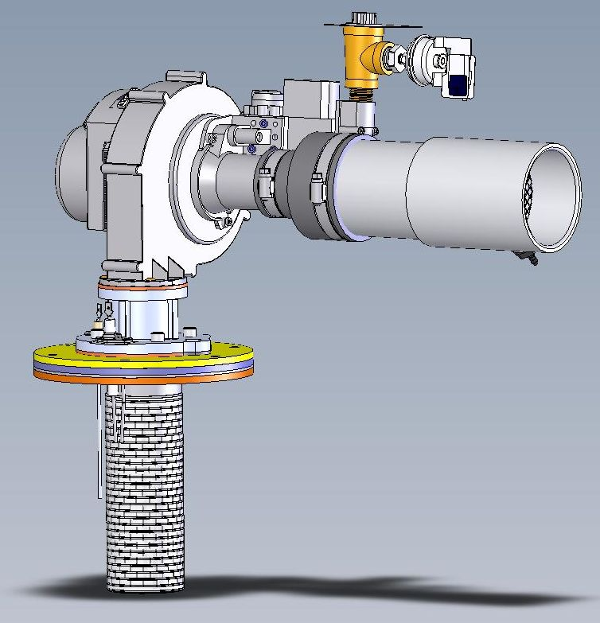
150 – 250 Models Combustion System
EBM RG148 Enhanced Blower
Honeywell VK8115FB Natural Gas Valve/Venturi Assy with 052 Venturi
Honeywell VK8115F LP Gas Valve/Venturi Assy with 052 Venturi
Acunit Burner
Kanthal APM Spark Electrode
.125” Spark Gap (between spark rod and ground rod)
¼” – 5/16” away from burner surface
Kanthal APM Flame Rod
½” away from burner surface
Aluminum Burner/Blower Adaptor
Burner Plate 6-Bolt Hole Pattern
409 SS Heat Shield

Slide 7
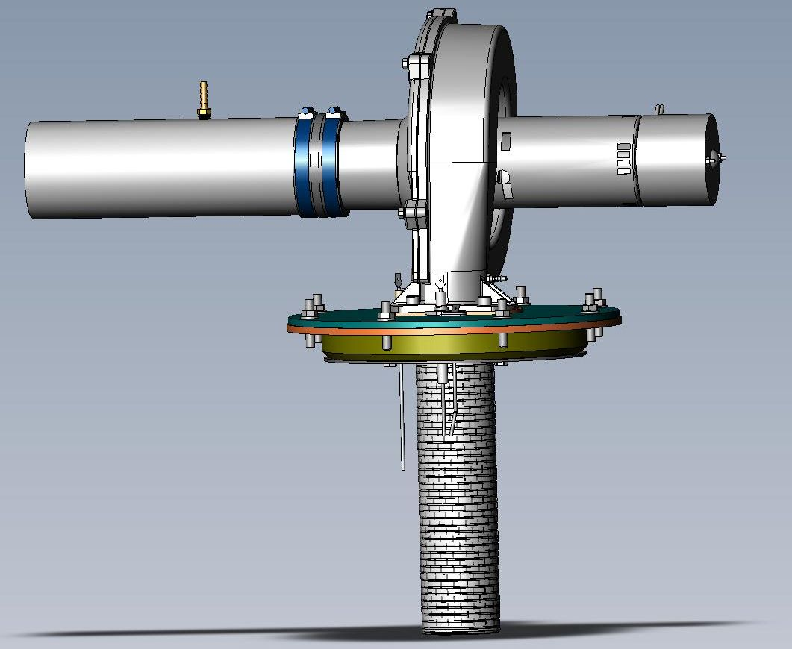
300 – 500 Models Combustion System
Fasco Blower w/Hall Effect Sensor (RPM feed back). Smaller blower foot
Dung’s Gas Valve
New Venturi Insert (Grey)
70mm Acunit Burner
409 SS Heat Shield
1” Pyrolite Insulation Block
Heat Shield and Insulation Block (bolted to the Burner Plate w/SS bolts and spacers)
Burner Plate 8-Bolt Hole Pattern
Kanthal APM Spark Electrode (different bend then 120-250)
.125” Spark Gap (between spark rod and ground rod)
¼” – 5/16” away from burner surface
Kanthal APM Flame Rod (Longer Ceramic) and Bent away from Burner
¾” away from burner surface

Slide 8
Key Marketing Features
Modulation benefits
Increased efficiency at lower firing rates
Fewer cycles result in longer service life
Quieter operation at lower fire rates
Modulation details
Modulates when within 30 degrees of set point
Input lowers closer to set point
Up to 3:1 modulation from largest model in family (120, 250, 500)

Slide 9
Modulation Details Continued…
Utilizes PID algorithm
Proportional
30°F proportional band
Full fire if temperature is >30°F below setpoint
Proportional to difference
Full fire at 30°F
Minimum rate fire at set point
Integral
Adds more speed the longer below set point
Subtracts speed the longer above set point
Differential
Looks ahead with rapid changes to adjust output

Slide 10
Modulation Details Continued…
After 8 min of continuous operation unit accelerates to full fire/RPM for 45 seconds
All blowers have RPM feedback back to controller
3 model families (120, 150-250,300-500) all have same pre-purge, ignition and post ignition RPM’s
Thermostat differential remains factory set at 8 degrees
Tank temp remains 12:1 upper probe to lower probe

Slide 11
Venting
3” & 4” vent size for 120 – 250 (Same as current models)
4” & 6” vent size for 300 – 500 (Same as current models)
Same max. equivalent vent length as current production
PVC, CPVC, PP, AL29-4C Vent Materials
ULC S636 Approved
Approved Polypropylene- M&G Duravent and Centrotherm InnoFlue
Approved AL29-4C are HeatFab Saf-T and Duravent FasNSeal

Slide 12
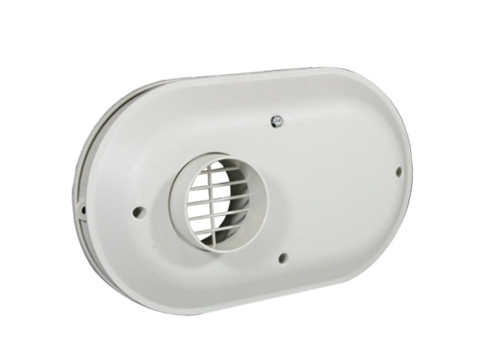
Venting
Vents lengths unchanged
Vent terminations
Standard termination (45 degree intake and 45 degree exhaust)
Concentric venting termination (Optional)
120 to 250 use 3” concentric
300 to 500 use 4” concentric
Low profile venting termination (Optional)
3 & 4” options

Slide 13
New Control Box
Low Voltage Field Wiring. CCB
Configuration Key
Power Supply
Transformer

Slide 14
New Control Sequence of Operation
Simplified Sequence
Call for heat
Pre-purge
Slow down blower and start spark
Wait for blower to stabilize
Turn on gas valve
Wait for flame signal
Ramp up to post ignition speed and wait
Ramp down to heating speed (or modulation)
End Call for heat
Post-purge speed
Standby

Slide 15
Powered Anode
Algorithm to adapt setpoint to low conductivity
Calibration checks of hardware and tank on power up and just under every two hours
New probe improvements to eliminate shorting at spud
Higher currents (up to 175mA)
Notes:
Have a separate presentation for powered anode.

Slide 16
Model Families
120 Model
Max modulation down to 78,000 Btu/h
Single anode
150 - 250 Models
Max modulation down to 78,000 Btu/h
Common parts on 150 – 250 models
300 – 500 Models
Max modulation down to 195,000 Btu/h
VFD (variable frequency drive)
Common parts on 300 – 500 models

Slide 17
Thinks to Know
Replacements will require vent realignment
Blower ramps up/down
Blower sound at high RPM with no intake
300 – 500 models are all 119 gallon now
300 model requires larger 4” concentric now
300-500 models are ¼” taller
High altitude up to 10,100 ft
We will market Modulation and its benefits but not publish 3:1 modulation rates

Slide 18
Rated Thermal Efficiencies
Model Size | Series 100 | New Series 200
120 | 94% | 95%
150 | 95% | 98%
199 | 95% | 97%
250 | 95% | 96%
300 | 96% | 96%
400 | 95% | 95%
500 | 95% | 95%

Slide 19
Reliability Improvements
Change to spark ignition
Modulation (fewer cycles and less thermal stress)
New vertically mounted pressure switches
Larger diameter fire tube (150 – 500 models)
Fire tube cone transition
Improved condensate drain
Powered anode enhancements
Improved low gas operation
Smoother light off

Slide 20
New/Enhanced Features
Modulation
Increased efficiency
Easy access exhaust and condensate
New vent material options
New low profile vent termination kits
Addition of recirculation loop return connection
Common parts

Slide 21
Summary
The best just got better, the bar has been raised again
New Series 200/201
No price increase related to these improvements
All model sizes released and ready for order

Slide 22
Cyclone Mxi Summary
Combination of feature and reliability improvements
Model numbers remain the same, new Series 200
No price increase related to these improvements
June 18th is order transition date

