Slide 1
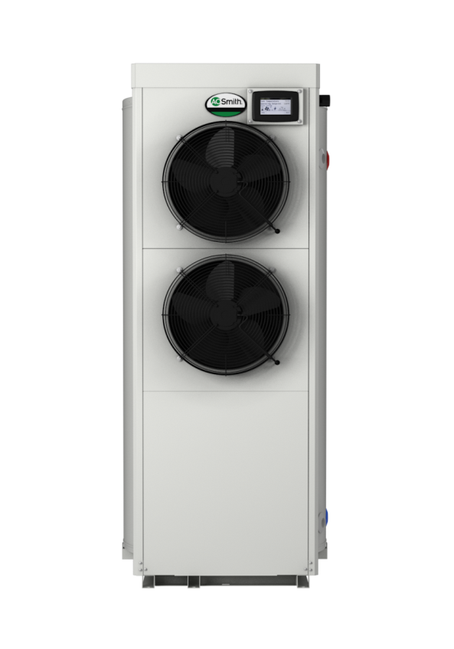
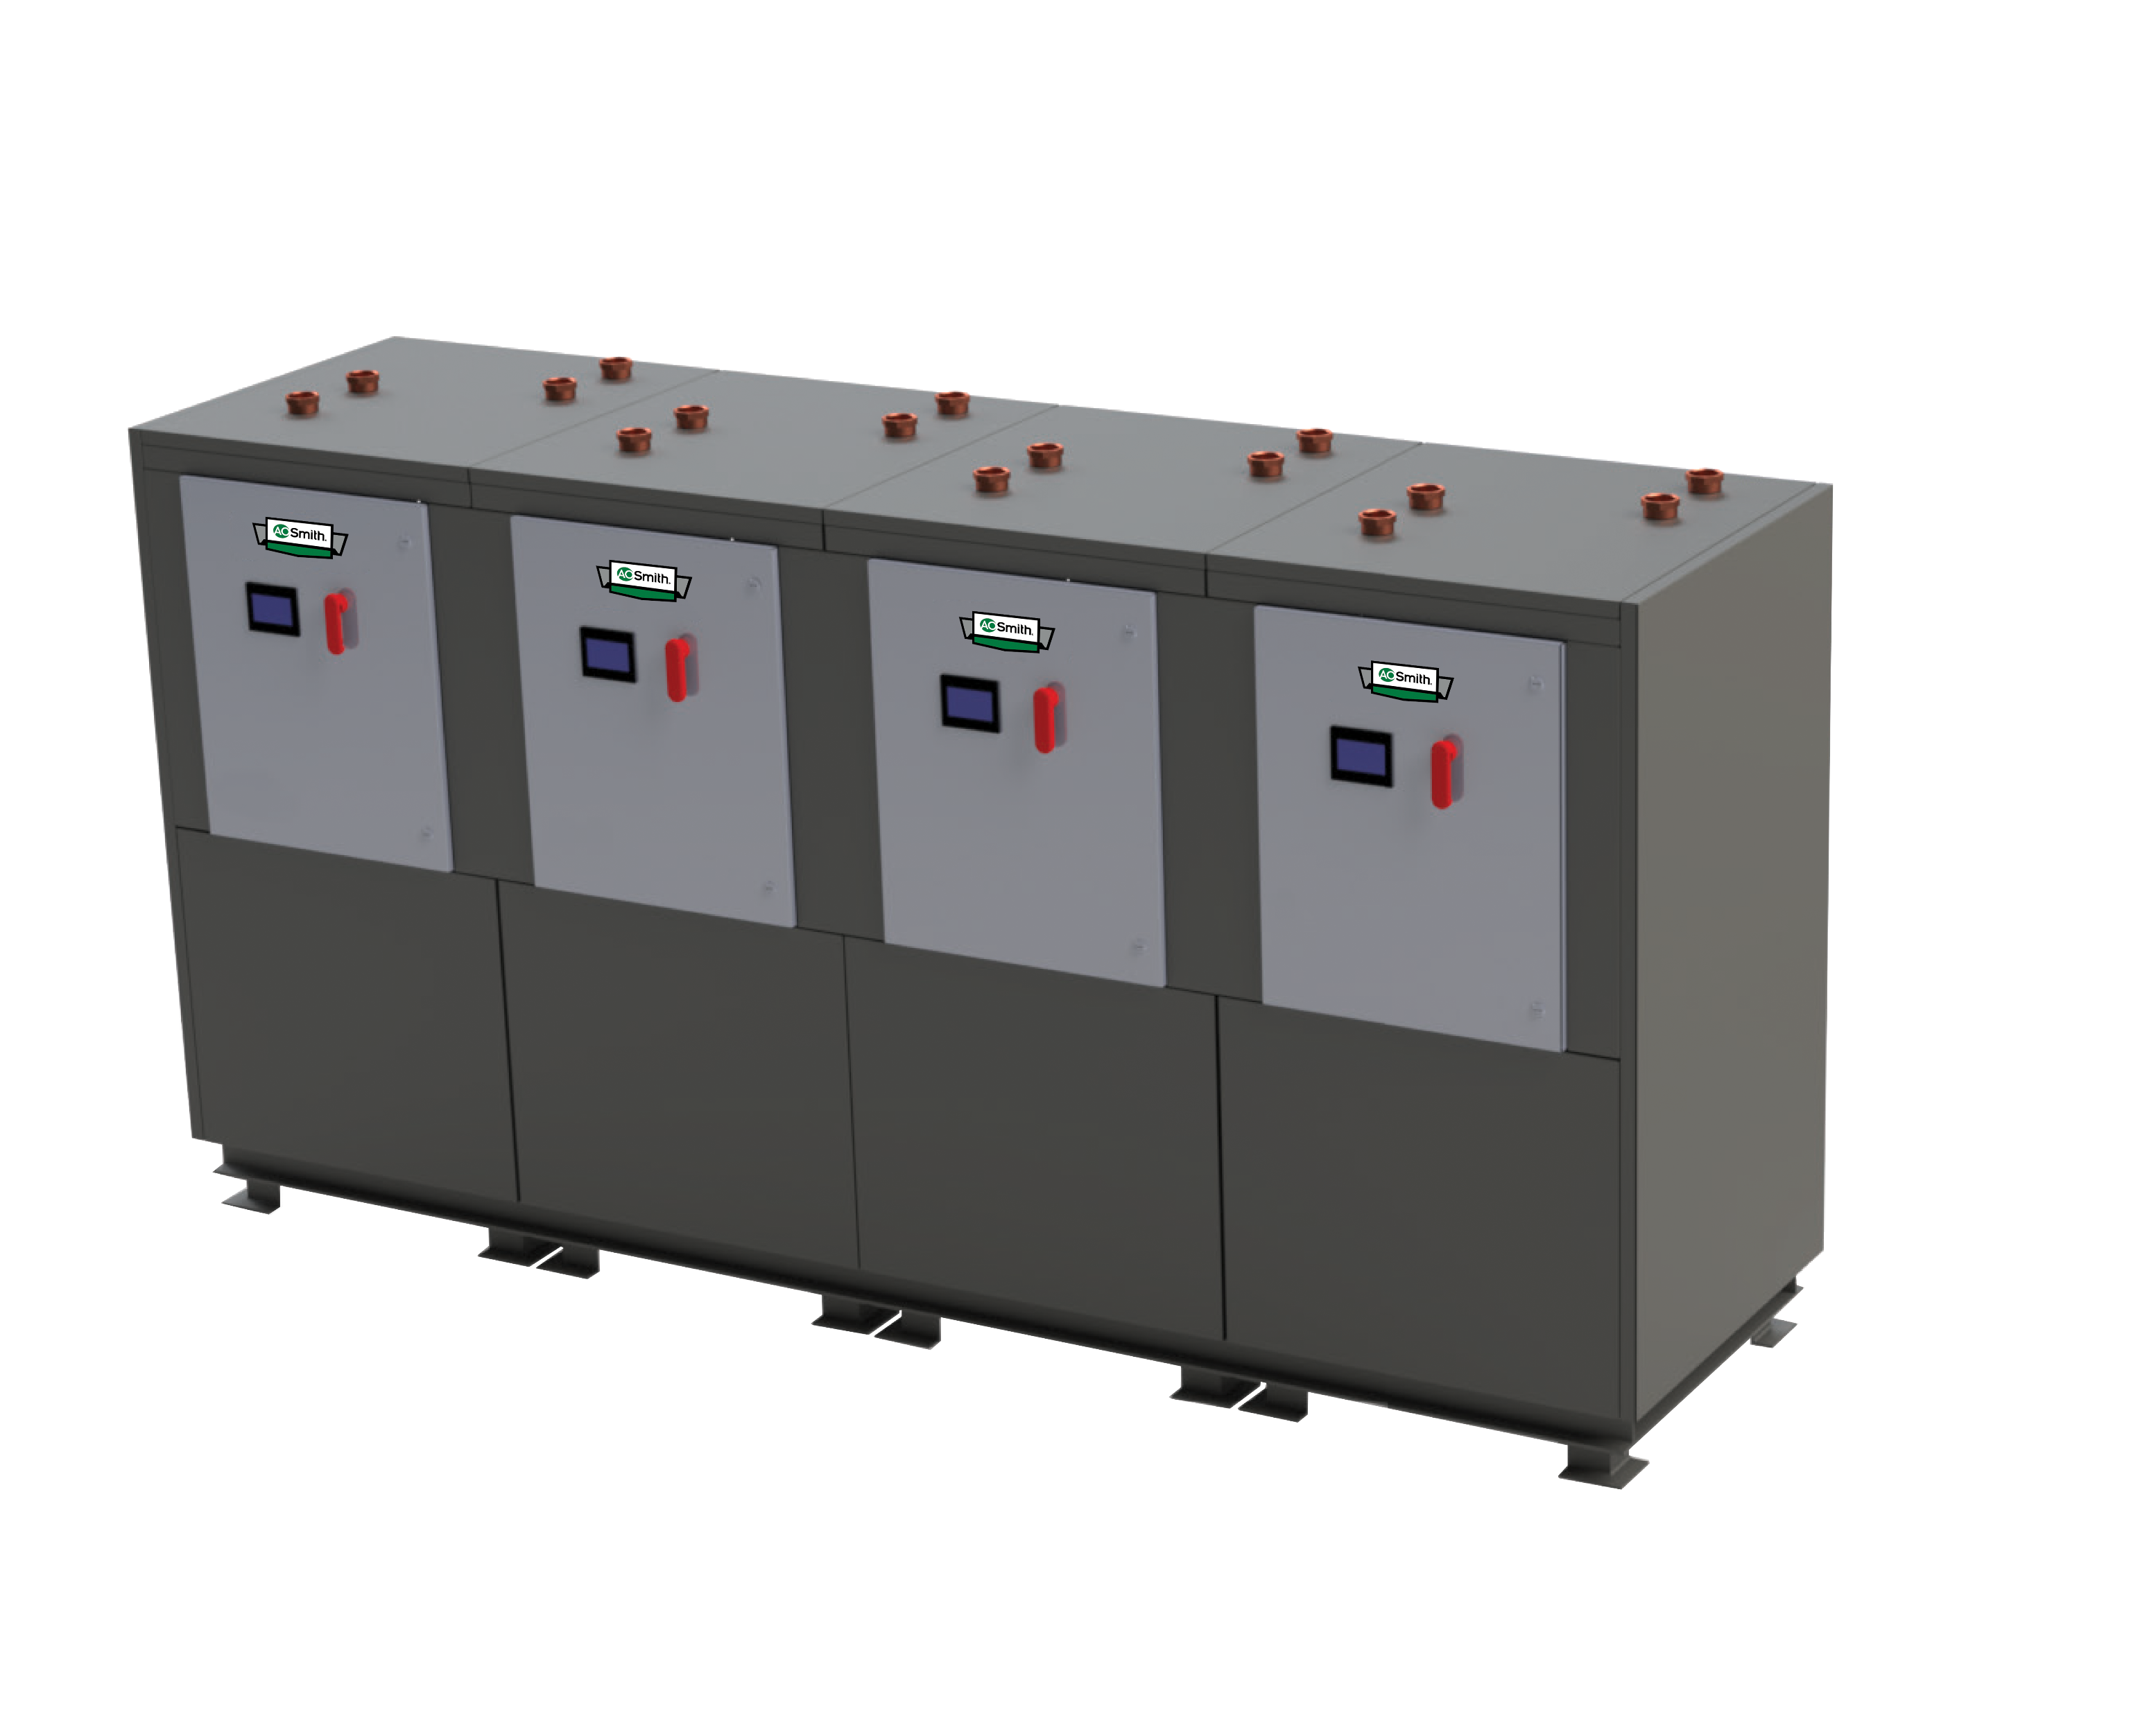
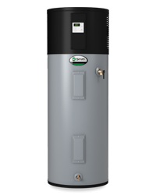
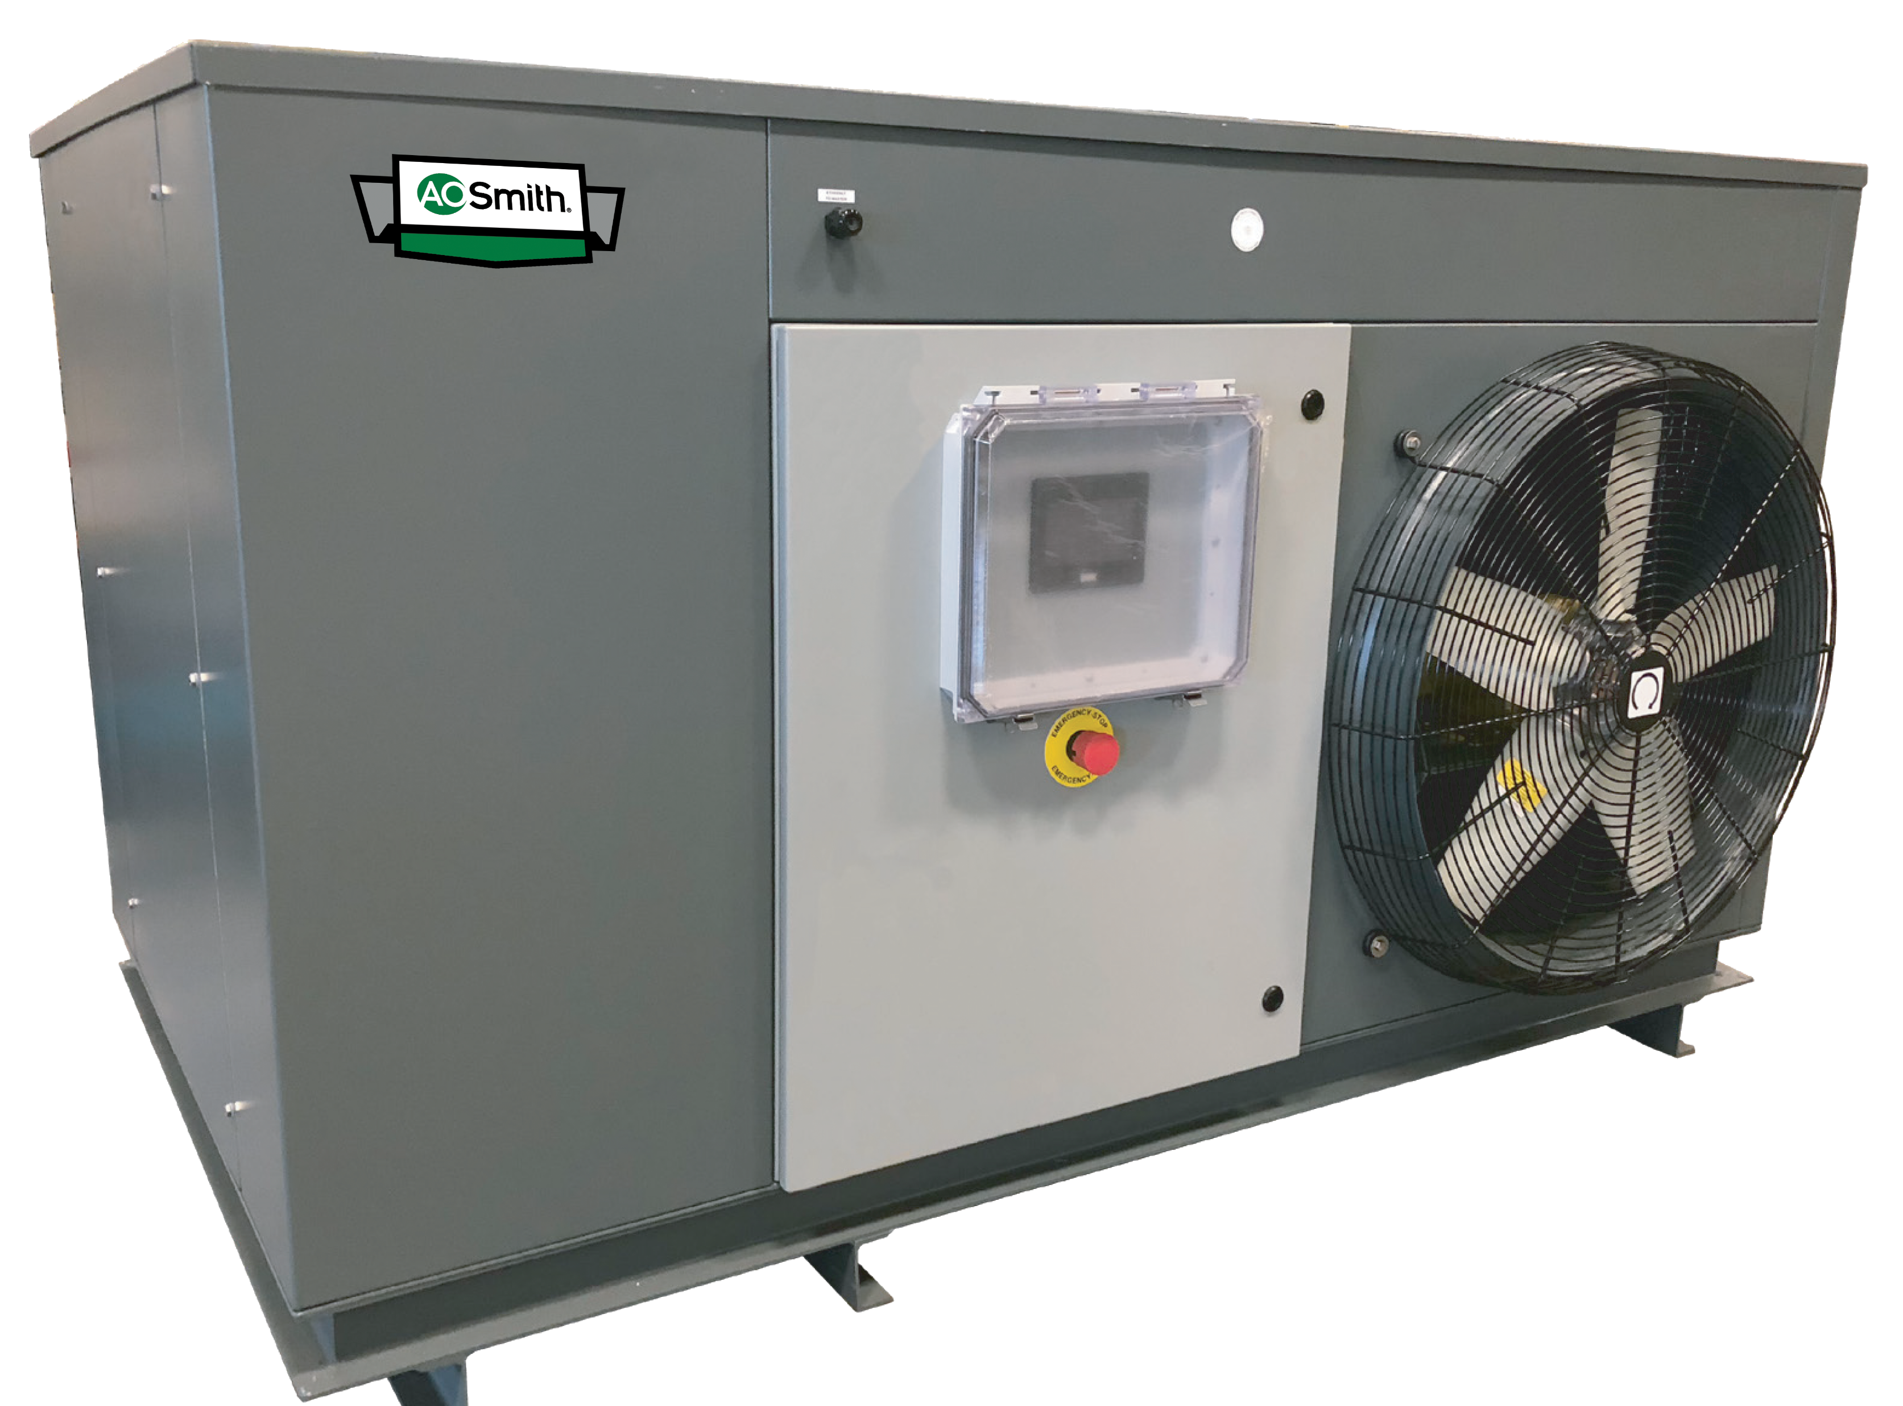
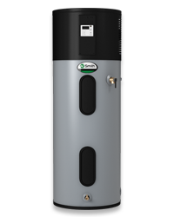
Intro to Heat Pump Water Heaters

Slide 2
Why Heat Pump Water Heaters (HPWH’s)?
Why is this technology growing?
Electrification and Decarbonization
Net Zero Emissions (NZE)
Green Initiatives
Sustainability Initiatives
LEED Construction Goals
How do HPWH’s meet those needs?
They capture heat from existing sources and utilize that energy for DHW
This reduces grid energy consumption which results in less emissions
This also saves the customer money on utility costs

Slide 3
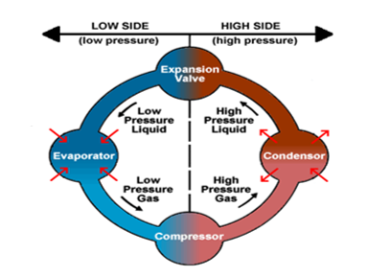
How Heat Pump Technology Works
Principles of Refrigeration
Heat Transfer occurs during phase changes
Liquids absorb heat energy when changed from liquid to gas.
Gases expel heat energy when changed from gas to liquid.
Heat Pump Technology utilizes these principles in a continuous cycle
For a refrigeration system to operate with economy, the refrigerant must be used repeatedly. For this reason, all refrigeration systems use the same cycle of compression, condensation, expansion, and evaporation in a closed circuit.
The same refrigerant is used to move the heat from one area to another, acting as a cooling medium on one side of the system and a heating medium on the other side of the system.
A refrigerant system must be a closed, sealed system and requires charging. Most HPWH’s will come pre-charged from the factory and ready to operate safely.

Slide 4
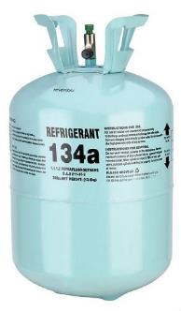
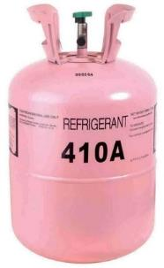
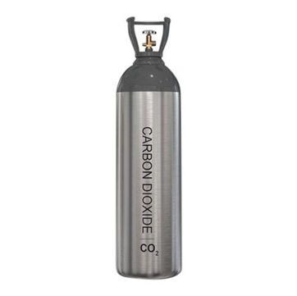
Heat Pump Technology - Refrigerant
R134a
R410A
CO₂
Refrigerant is the heat transfer vehicle in the heat pump system
Changes state from gas to a liquid and back to gas depending on temperature and pressure
Every refrigerant has a different pressure to temperature relationship, which is published in Pressure Temperature (PT) Charts

Slide 5
Expansion Valve
Low Pressure Liquid
High Pressure Liquid
Liquid
Low Pressure
High Pressure
Evaporator
Condenser
Gas
Low Pressure Gas
High Pressure Gas
Compressor

Slide 6
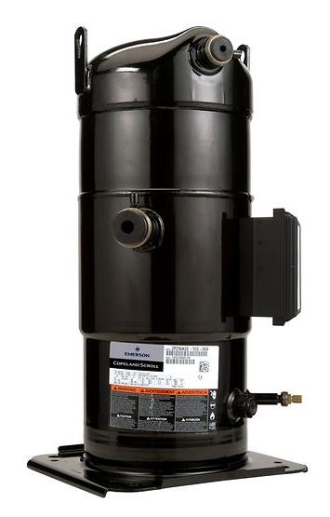
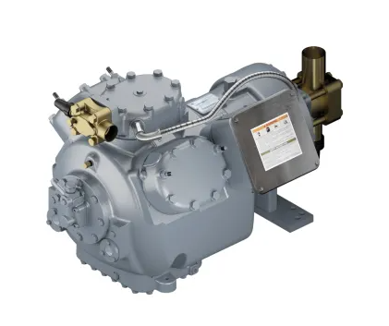
How a HPWH Operates - Compressor
Compressor
The compressor is the heart of the system.
Divides the high and low pressure side of the gas portion of the cycle.
Does just what its name implies. It compresses the low pressure refrigerant vapor from the evaporator and turns it into a high pressure vapor.
The compressor is where most of the electrical energy is used in a HPWH.
The inlet to the compressor is called the “Suction Line”. It brings the low pressure vapor into the compressor.
After the compressor turns the refrigerant into a high pressure vapor, the refrigerant exits through the “Discharge Line”.

Slide 7
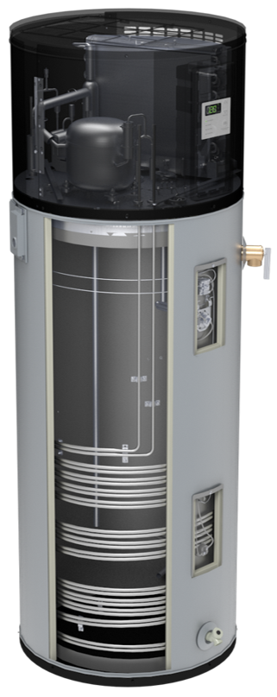
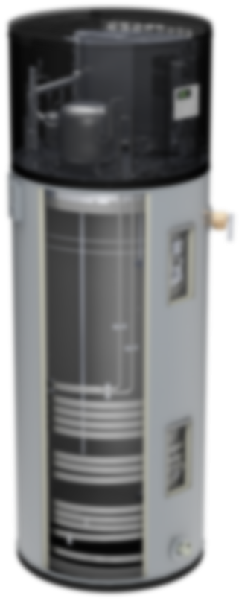
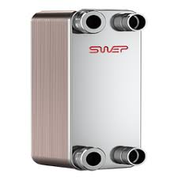
How a HPWH Operates - Condenser
Condenser
The condenser is a heat exchanger that transfers heat energy from the refrigerant to the water.
This is where the actual water heating occurs in a HPWH.
Refrigerant enters the condenser as a high pressure gas and exits as a high pressure liquid, leaving along what is called the “Liquid Line”.
There are multiple styles of heat exchanger used as a condenser depending on the type of HPWH.

Slide 8
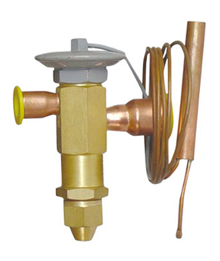
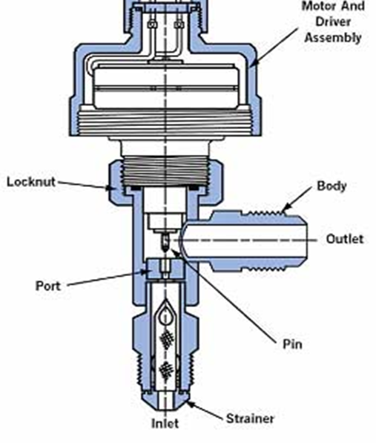
How a HPWH Operates – Thermal Expansion Valve
Thermal Expansion Valve (TXV)
The TXV controls the flow of refrigerant to maintain a specific balance going back into the evaporator.
The “Liquid Line” feeds into the TXV where it is turned into a flash gas mixture.
Pressure is decreased to a certain point so that the refrigerant undergoes a partial phase change, leaving as mostly liquid but also some gas.
The TXV separates the high and low pressure sides of the system.

Slide 9
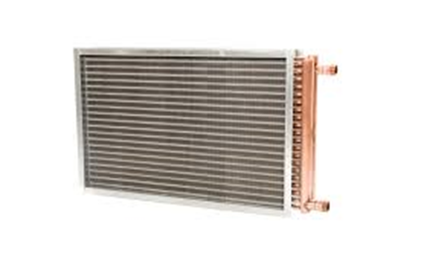
How a HPWH Operates – Evaporator
Evaporator
The evaporator is where the heat energy enters the refrigerant system.
Heat energy is absorbed from the heating medium (air or water) into the refrigerant cycle via a heat exchanger.
The heating medium will be cooled as it passes through the evaporator, typically by a set amount (Delta T).
Refrigerant enters the evaporator as a mixture and exits as a low pressure gas.
The evaporator separates the liquid and gas side of the system.

Slide 10
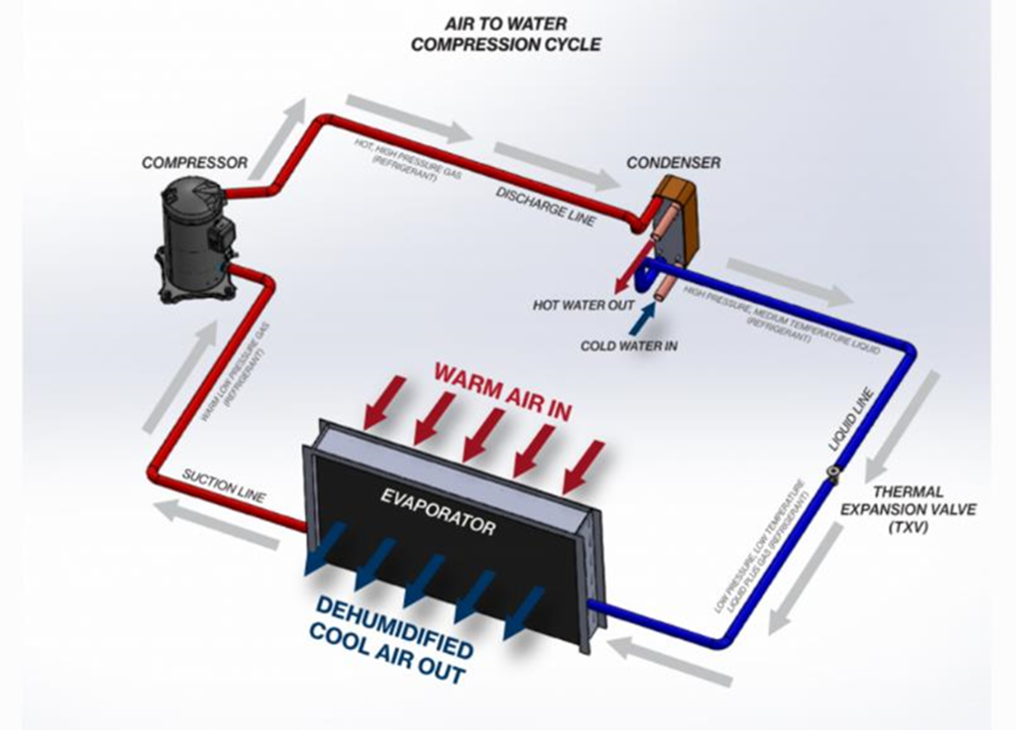
How a HPWH Operates – Air Source

Slide 11
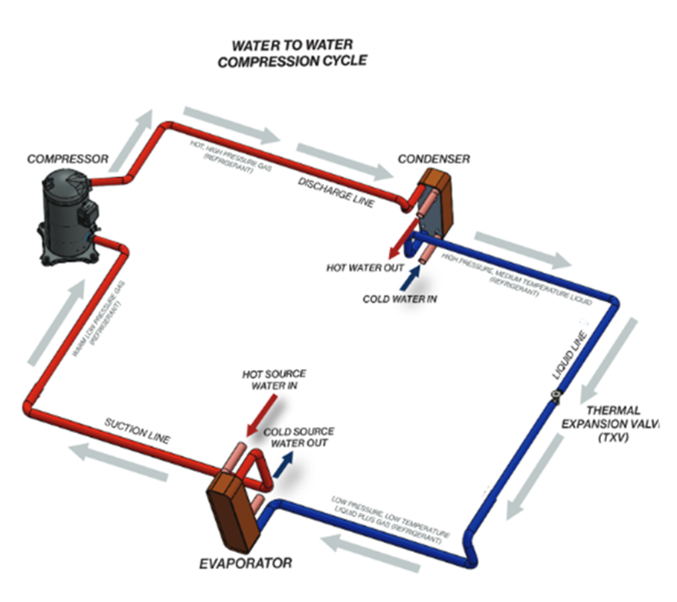
How a HPWH Operates – Water Source

Slide 12
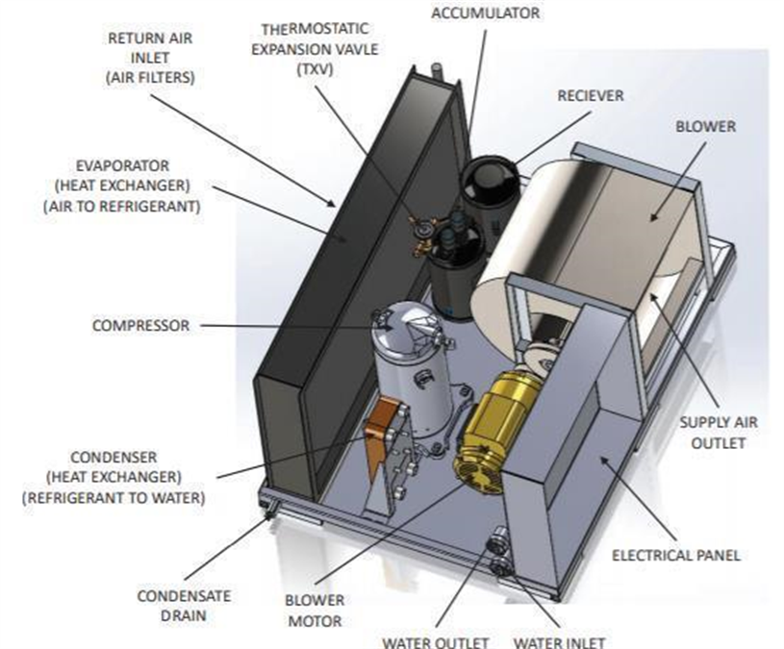
How a HPWH Operates – Components

Slide 13
HPWH Design – Types
There are two main divisions of Heat Pump Water Heater Systems
Integral Storage Systems
These are HPWH’s that contain their own internal storage and are typically designed to be fully functional stand-alone units.
Most residential and small commercial units are this style of HPWH.
Typically air source, and indoor only units.
Ideal for applications with low to medium demand, space limitations, and warm air availability.

Slide 14
HPWH Design – Types
There are two main divisions of Heat Pump Water Heater Systems
Separate Storage Systems
These are HPWH’s that have no internal storage so are paired with properly sized storage tanks for the application.
Sometimes called “split” to differentiate from integral systems.
Can be air or water source, and typically can be placed indoors or outdoors.
Units exist in varying capacities and can meet the needs of a wide range of applications, often utilizing multiple units when necessary.

Slide 15
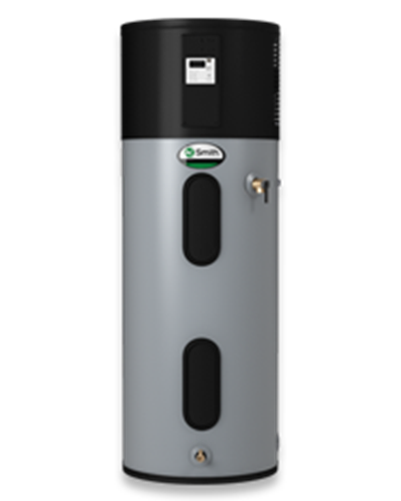
HPWH Design - Residential Style Water Heaters
Evaporator
Compressor
Upper Heating Element
Condenser Coil
Lower Heating Element

Slide 16
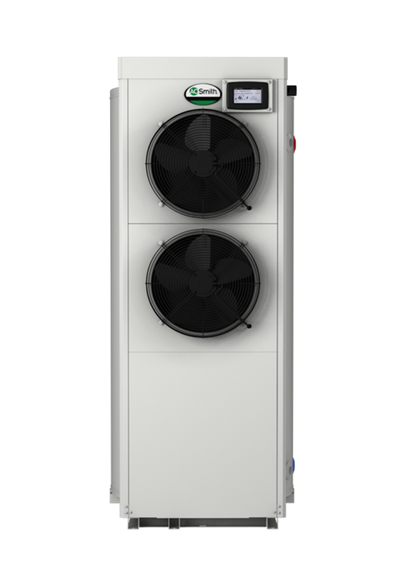
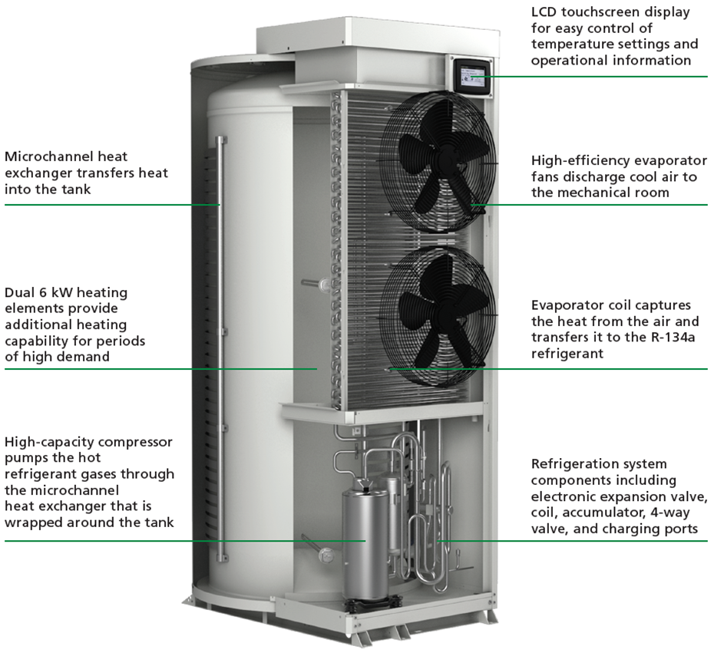
HPWH Design - Commercial Style Water Heaters Integrated Storage Type

Slide 17
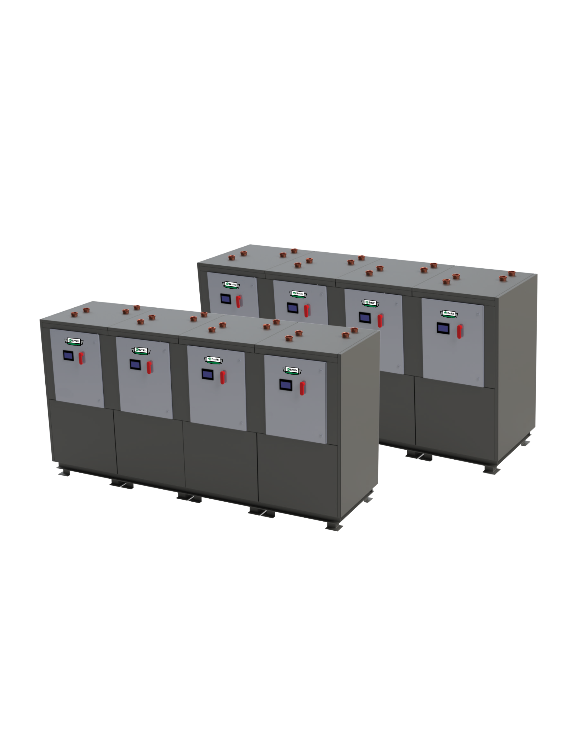
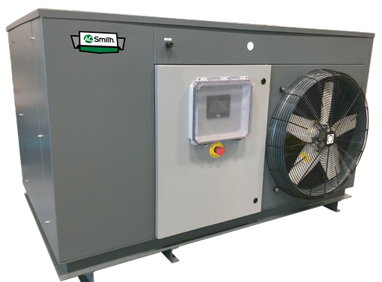
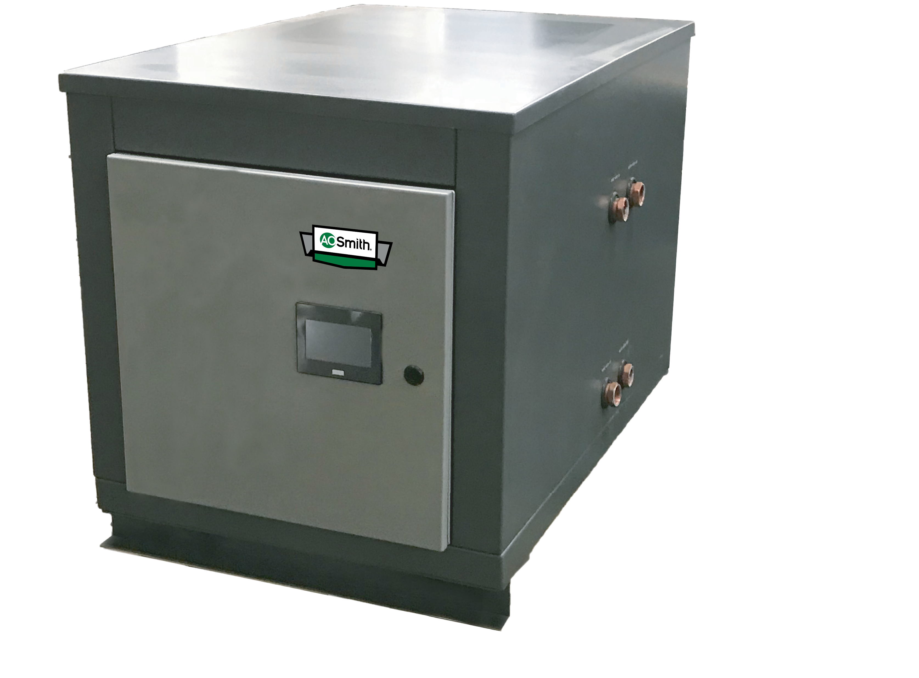
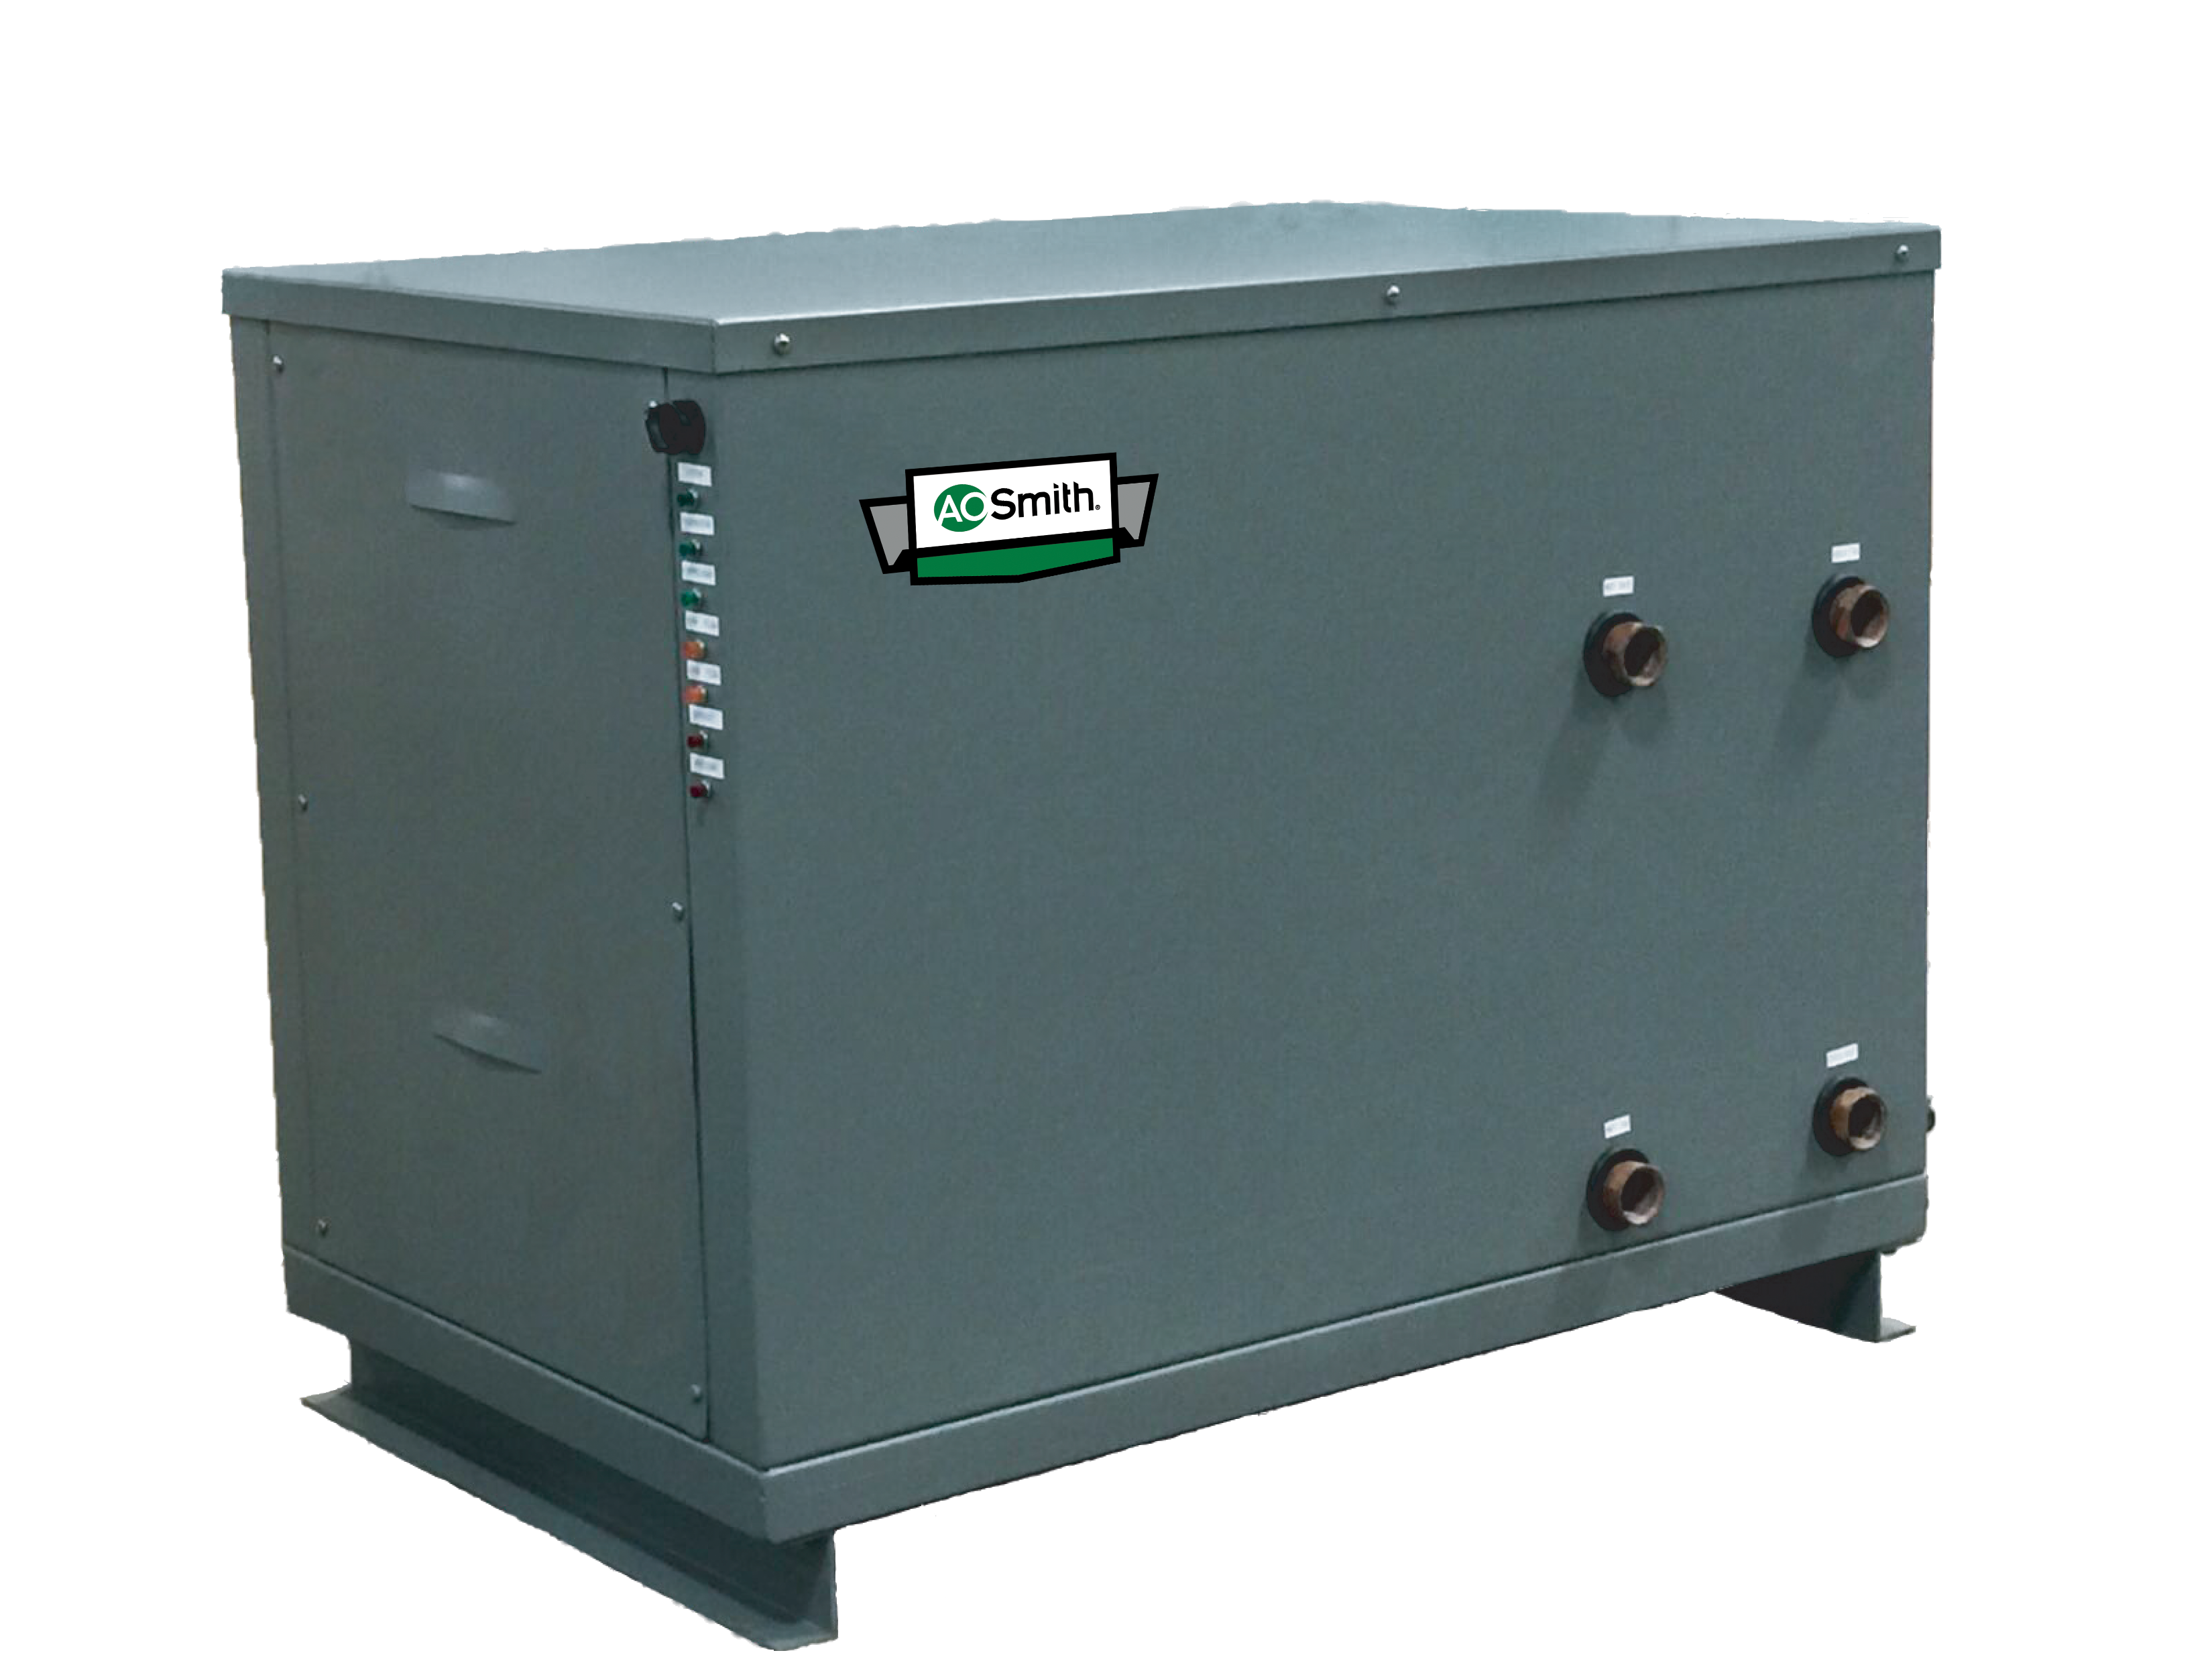
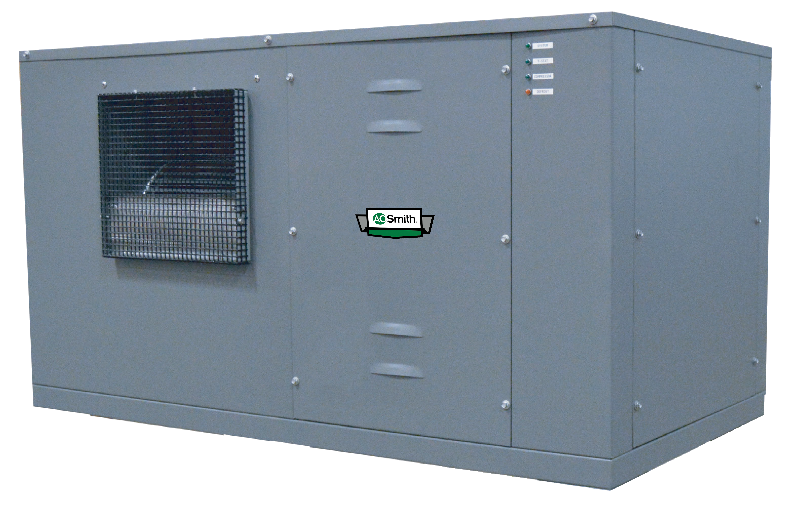
HPWH Design - Commercial Style Water Heaters Split Type

Slide 18
HPWH Application and System Design Factors
Items to Consider
Regulations and Local Codes
Demand Profile
Heating Source Availability
Operating Costs
Installation Constraints

Slide 19
HPWH Application and System Design Factors
Regulations and Local Codes
Federal regulations are becoming ever more stringent in terms of energy usage and emissions for water heaters.
Some municipalities such as Berkeley, CA have instituted a complete moratorium on fossil fuel burning appliances (such as gas-fired water heaters).
HPWH’s often have a significant positive affect on ENERGY STAR or HERS scores for the respective types of building.
Many utility districts currently offer large instant rebates for residential HPWH’s, and are beginning to offer rebates for commercial customers as well.

Slide 20
HPWH Application and System Design Factors
Demand Profile
HPWH’s are designed for applications in which they can recover a properly sized amount of storage during off-peak periods.
Applications with constant, high volume DHW flow are not ideal for heat pump water heaters.
Depending on application conditions, a swing tank (typically in the form of an electric water heater) may be required to handle surges in demand.
Often the demand profile will be the primary contributing factor in whether the system will be a single or multi pass design.

Slide 21
HPWH Application and System Design Factors
Heating Source Availability
Air source HPWH’s need a minimum volume of air available to function efficiently, and have source air temperature limitations.
Water source HPWH’s need a certain flow of heating water to maintain proper heat transfer in the evaporator.
Different types and sizes of HPWH’s have varying requirements regarding temperatures of their respective heating mediums.
Typically, the warmer the heating medium the more efficient a HPWH will be.

Slide 22
HPWH Application and System Design Factors
Operating Costs
HPWH’s are measured in terms of Coefficient Of Performance (COP), which is used as a measure of energy efficiency greater than 100% (COP of 1.0 = 100% efficiency).
A HPWH will provide more heating capacity than the amount of electrical energy that it consumes which results in significant savings over standard electric water heaters.
Most HPWH’s have a COP from 2.0 - 6.0, so for a unit with a COP of 4.2 that means that for every $1 of electricity the unit will produce $4.20 of heating.
Maintenance is only needed infrequently, resulting in low average annual costs.

Slide 23
HPWH Application and System Design Factors
Installation Constraints
Many units can be placed indoors or outdoors, with the primary requirement being that they have access to the proper heating source.
Common locations for HPWH’s are mechanical rooms, basements, rooftops, and parking garages.
Most HPWH’s are not overly large, but multiple units may be needed for large buildings and most commercial split units will need accompanying storage.
For air source HPWH’s, they can usually be ducted and will give off cooled, dehumidified air as a by-product.
Be sure to consider electrical service availability and amp draw, which can vary.

Slide 24
Heat Pump Water Heater Applications
Ideal Applications
Single-Family
Multi-Family
Hotels
Restaurants
Office Buildings
Schools
Dormitories
Hospitals
Applications to Avoid
Commercial Laundries
Industrial Processes w/ Constant Flow
Car Washes
Emergency Fixtures (Shower/Eyewash)

Slide 25
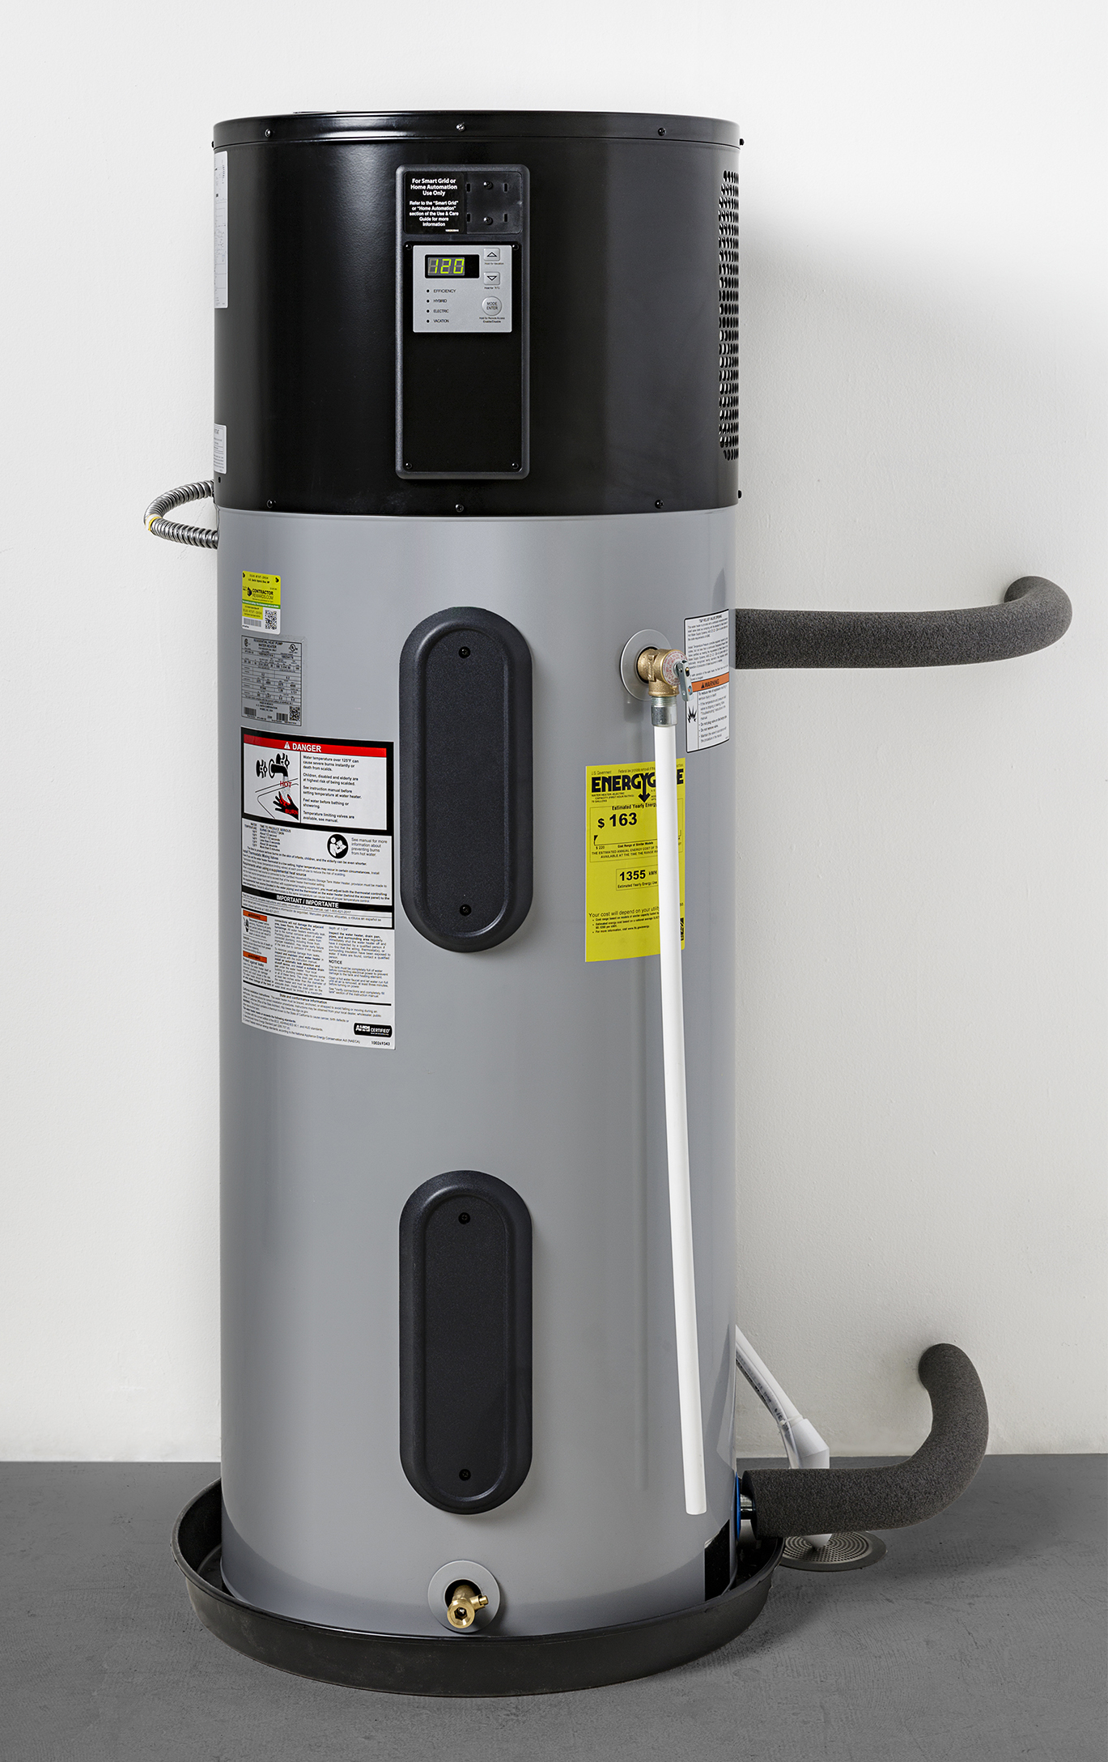
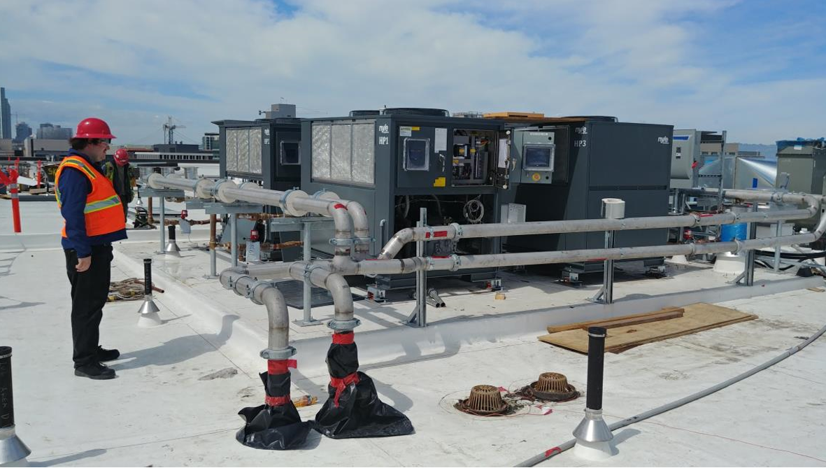
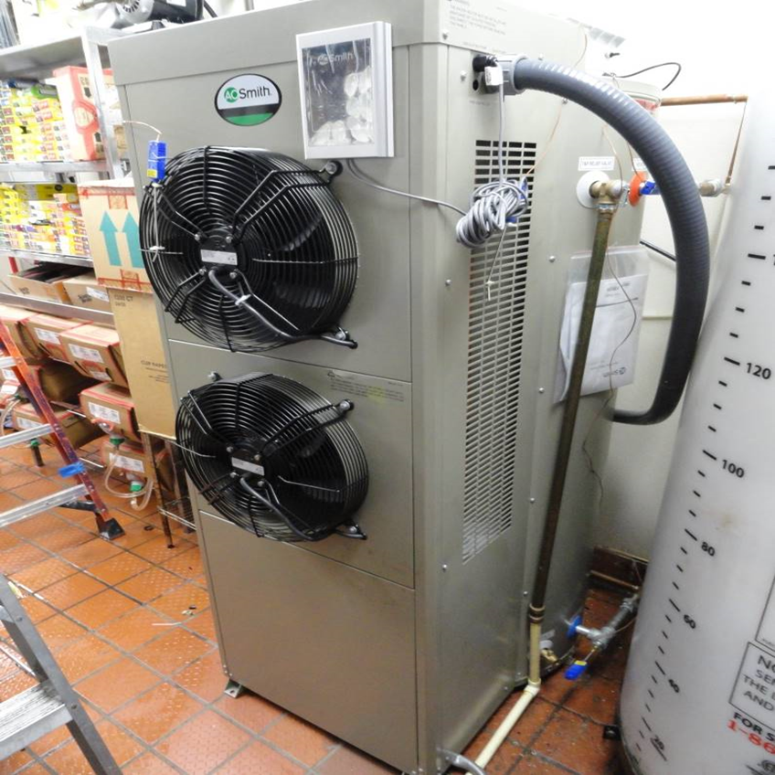
Heat Pump Water Heater Applications

Slide 26
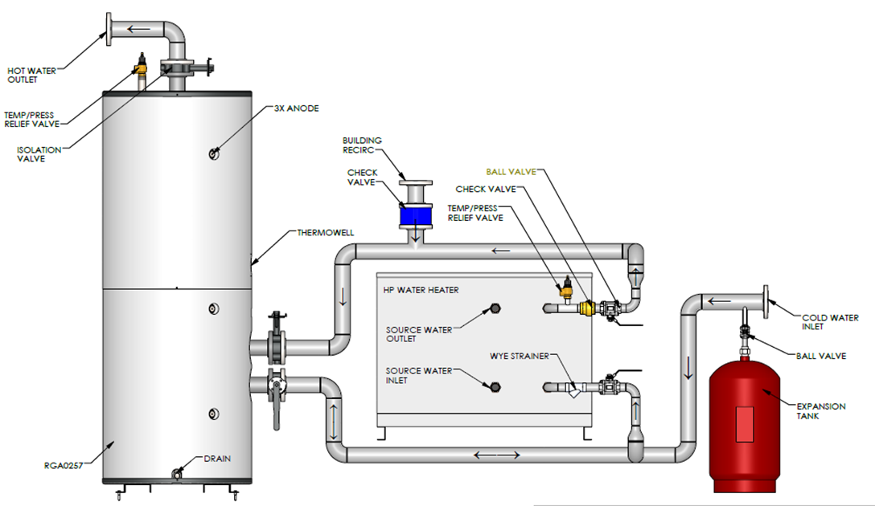
Heat Pump Water Heater Applications Multi-Pass System

Slide 27
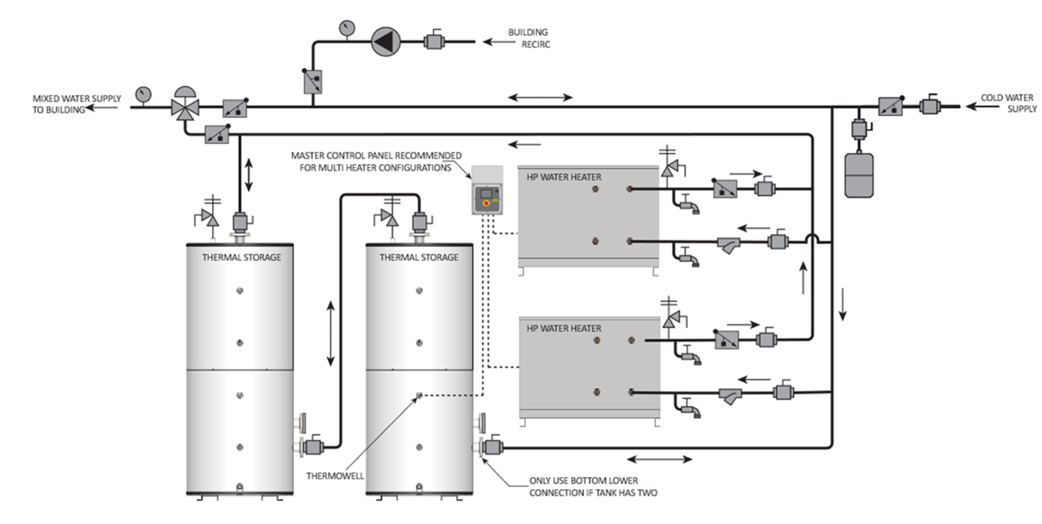
Heat Pump Water Heater Applications Single Pass System

Slide 28
Heat Pump Water Heater Pros and Cons
Pros
Environmentally Friendly
Possibility for Full Payback
Versatility
Provide Cooled Air
Utility Rebates/Incentives
Satisfy Government Regulations
Easy to Maintain
Cons
Initial Equipment Costs
Space for Separate Storage
Need Consistent Heating Source

Slide 29
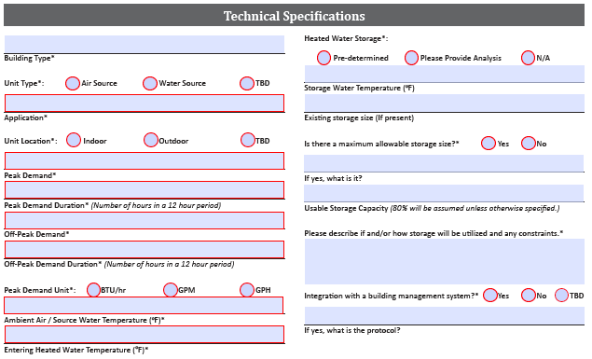
Heat Pump Water Heater Sizing
Items to Consider
Complete Demand Profile
Stored Water Temp vs Building Supply Temp
Heat Source Parameters
System Balance for Optimal Efficiency
Potential for Electric Back-up

Slide 30
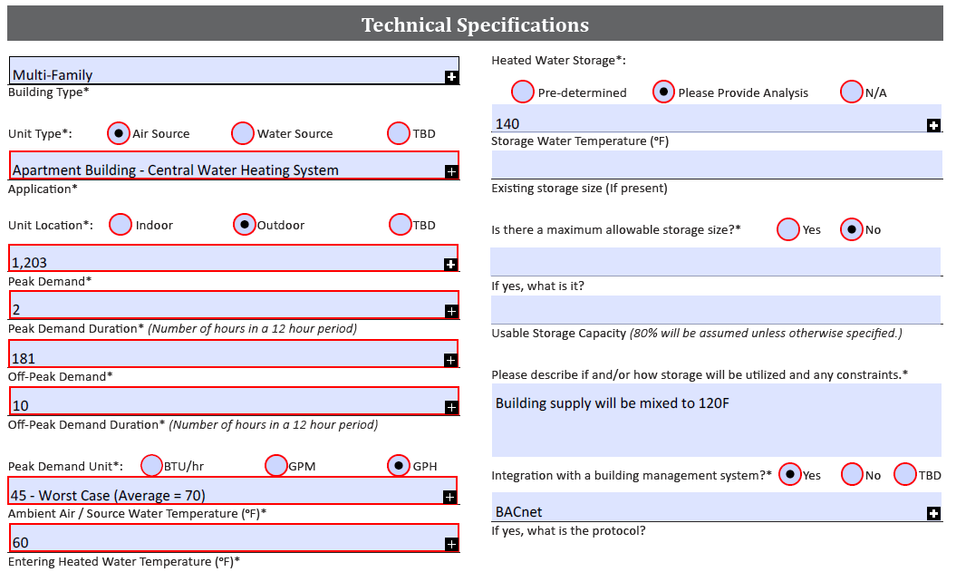
Heat Pump Water Heater Sizing Example
Multi-Family – Apartment Bldg.
Location – Southern California
Mix of Unit Types
(80) 1BR, 1Ba Units
(60) 2BR, 2Ba Units
(20) 3BR, 2-1/2Ba Units
All units have dishwasher and clothes washer
Medium Peak Demand – 2 Hours
Air Source, Outdoor Units

Slide 31
Heat Pump Water Heater Sizing Example
Peak Demand – 1,203 GPH
Peak Duration – 2 Hours
Off-Peak Demand – 181 GPH
Off-Peak Duration – 10 Hours
Ambient Air – 45F Worst Case
Incoming Domestic Water – 60F
Stored Water Temperature – 140F
Building Supply Temperature – 120F

Slide 32
Heat Pump Water Heater Sizing Example
Demand:
Peak Energy Demand – 601,981 BTU/hr
Off-Peak Energy Demand – 90,572 BTU/hr
Recommendation:
(3) 90,000 BTU/hr Rated Units
Approximate Recovery @ 140F = 331 GPH
Worst Case Air Temp of 45F
Approximately 222,000 BTU/hr
Tank Recovery Time After Peak = 6 Hours
1,500 Gallons of Storage
Total BTUs available – 800,640
80% Usage Factor
140F Stored Temp

Slide 33
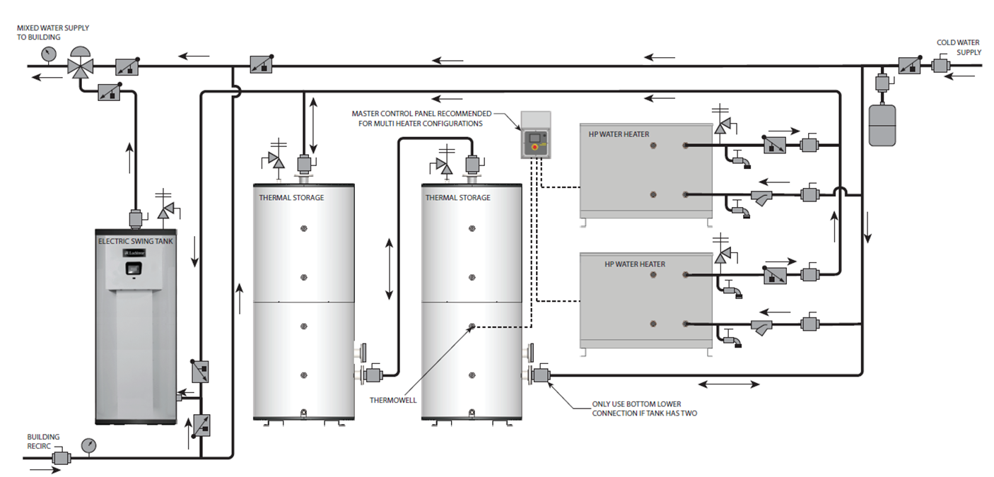
Heat Pump Water Heater Sizing Example Single Pass System w/ Electric Swing Tank

Slide 34
Heat Pump Water Heater Sizing Example
Energy Savings Calculation
Annual Energy Use (5,000 gallons/day)
HPWH System (COP of 3.5) – 75,000 kWh
Standard Electric System – 270,000 kWh
Natural Gas System – 16,000 Therms
Energy Prices
kWh - $0.20
Therm (Natural Gas) - $1.50
Comparison (Annual Energy Costs)
HPWH System - $15,000
Standard Electric System - $54,000
Natural Gas System - $24,000
Maximum Annual Savings - $39,000

Slide 35
Heat Pump Water Heater Sizing Example
Payback Calculation
Total Budgetary Equipment Cost
HPWH’s - $100,000
Storage Tanks - $28,000
Electric Swing Tank - $12,000
Total Budgetary Equipment Cost - $140,000
Maximum Annual Savings - $39,000
Payback = Total Cost/Annual Savings
Payback Period – 3.6 Years

Slide 36
Questions?

