Slide 1
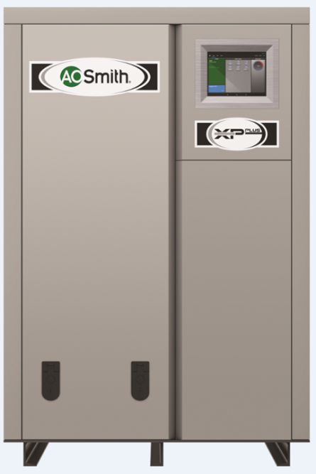
XP ^{PLUS} Intro
High Efficiency Circulating Water Heater

Slide 2
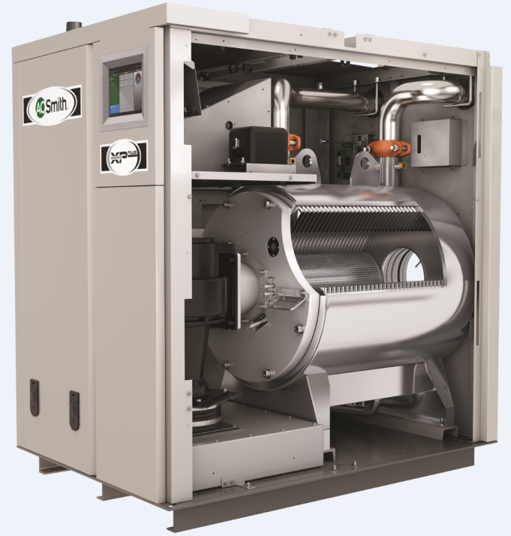

New XP ^{PLUS}
New design high input models
Replaces existing McBee large XWH models
Inputs 1.25M to 4M, our largest
Matches with storage tank
Industrial and large commercial applications

Slide 3
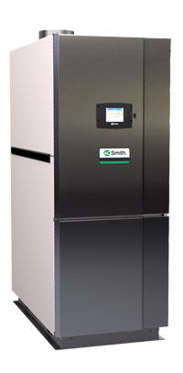
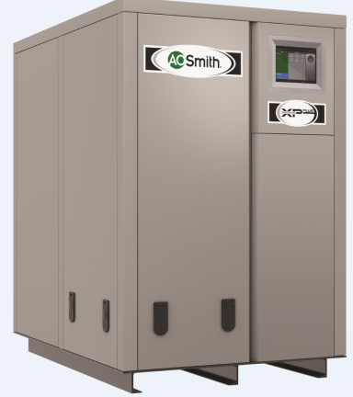
Comparison

Slide 4
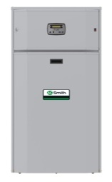
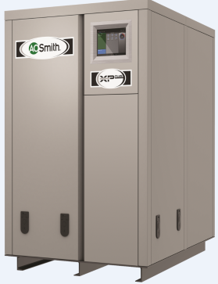
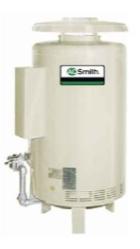
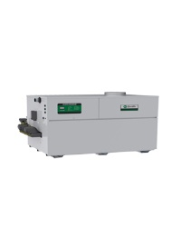
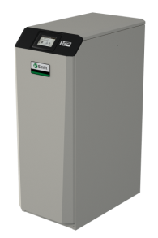
Circulating Water Heater Line
Model Family | HW Burkay | Genesis | VF | XP | XP^{PLUS}
Design | Non-Condensing |  |  | Condensing | Condensing
BTU/HR Range | 120K-670K | 399K-2.1M | 500K-2M | 150K - 800K | 1.25M – 4.0M
Modulation | None | Staged Fired | 4:1 | 5:1 | 5:1
Heat Exchanger | Copper Fin Tube | Copper Fin Tube | Copper Fin Tube | Stainless Steel | Stainless Steel

Slide 5
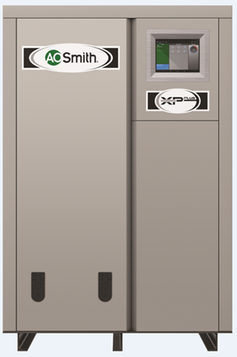
XP ^{PLUS}
Dimensions
UNIT | WIDTH | HEIGHT | DEPTH
PWH-1250NP | 34" | 51-1/2" | 49"
PWH-1500NP | 34" | 51-1/2" | 52-3/4"
PWH-2000NP | 34" | 51-1/2" | 65-1/2"
PWH-3000NP | 48-1/4" | 67-1/4" | 79-3/4"
PWH-4000NP | 48-1/4" | 67-1/4" | 96"

Slide 6
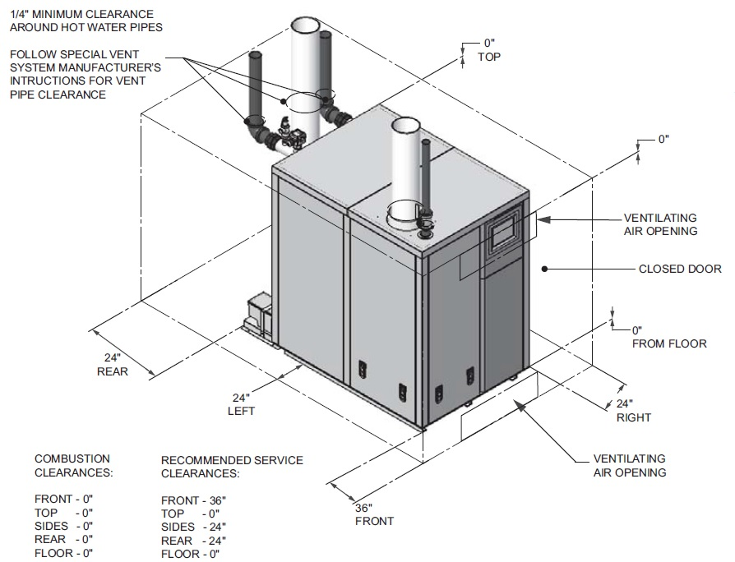
XP ^{PLUS} Clearances

Slide 7
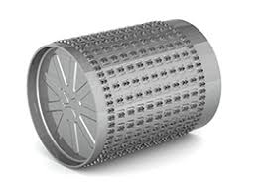
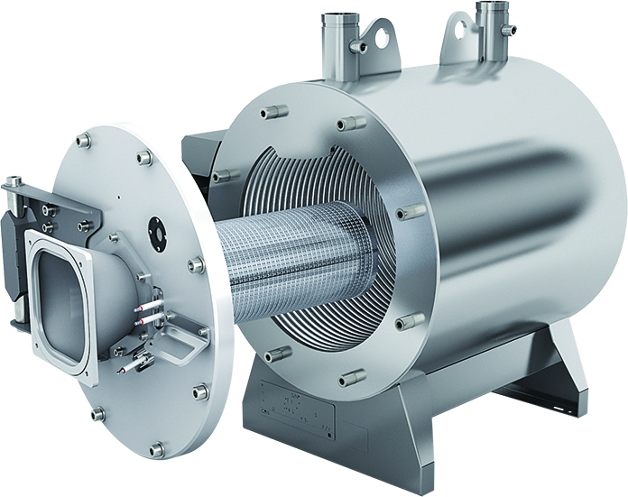
XP ^{PLUS} Heat Exchanger
Heat Exchanger
  5:1 Turndown Combustion System
  Heavy-Duty 316L Stainless Steel Heat Exchanger
  Rail Mounted Door for Excellent Serviceability
  5-Year Non-Prorated Warranty
Notes:
Here is an image of the new large input heat exchanger.
First, the burner is the key component in the combustion system that operates on a 5:1 turndown. The radial burner is 411 stainless steel and designed exclusively for this high quality heat exchanger.
The heavy duty heat exchanger is 316L Stainless Steel. It is a water tube design meaning with put the water inside the tubes which is key for flow control and lime scale free operation.
I cannot impress upon you how substantial this heat exchanger is. The door (into which the burner is mounted) is cut from 1-1/2 inch think stainless steel. It is so heavy that the door is mounted on a rail that allows us to pull the door back and turn it on a hinge for service access.
A heat exchanger this strong deserves nothing less than a five year non-prorated warranty.

Slide 8
XP ^{PLUS} Vent Sizes and Lengths

Slide 9
XP ^{PLUS} Vent Materials PVC/CPVC

Slide 10
XP ^{PLUS} Vent Materials Polypropylene

Slide 11
XP ^{PLUS} Vent Materials Stainless Steel

Slide 12
XP ^{PLUS} Direct Vent Options

Slide 13
XP ^{PLUS} Venting Options – Room Air

Slide 14
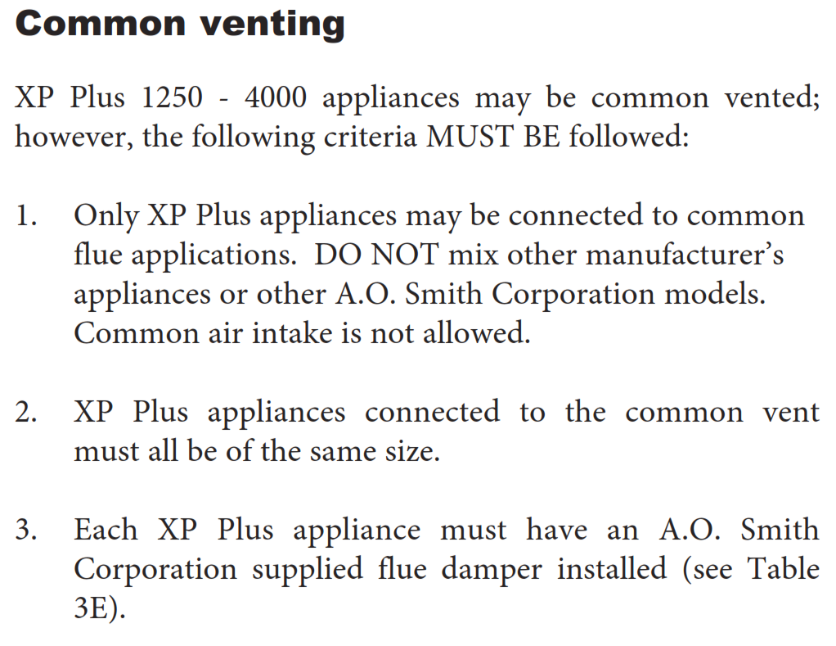
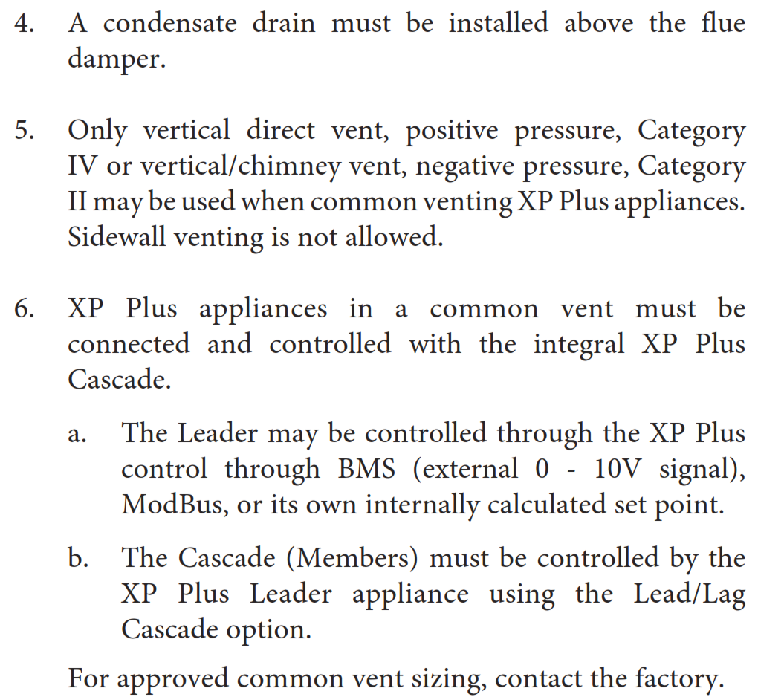
XP ^{PLUS} Venting Options – Common Vent

Slide 15
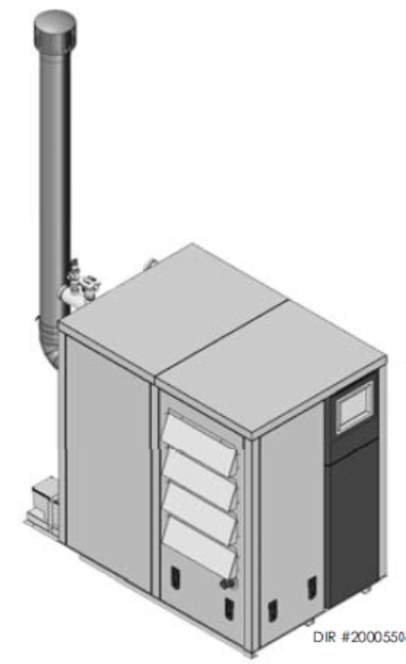
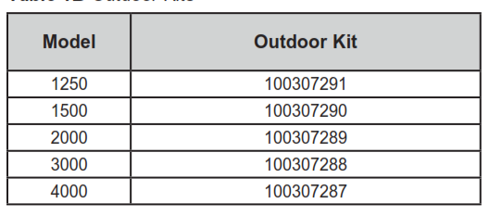
XP ^{PLUS} Outdoor Applications

Slide 16
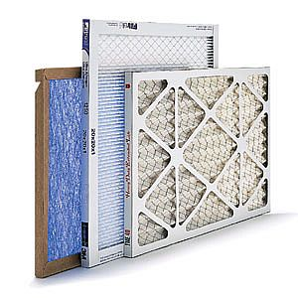
XP ^{PLUS} Combustion Air Filter
Models
  PWH1.25
  PWH1.5
  PWH2.0
      Filter Size - 16 x 20 x 1
  PWH3.0
  PWH4.0
      Filter Size - 24 x 30 x 1

Slide 17
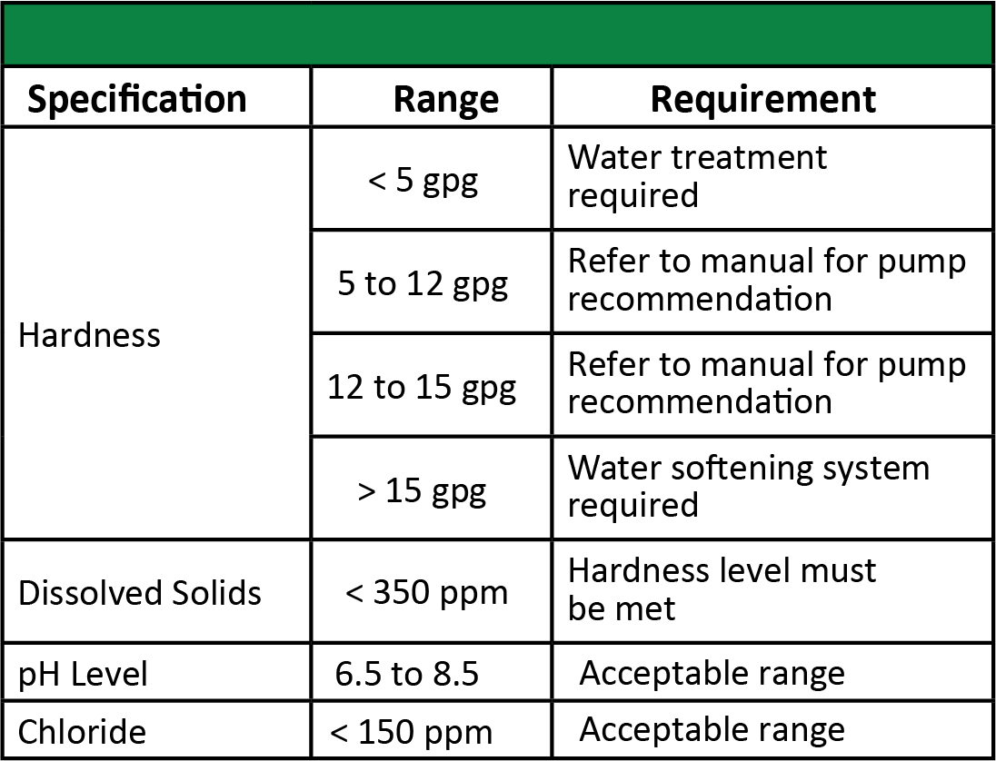
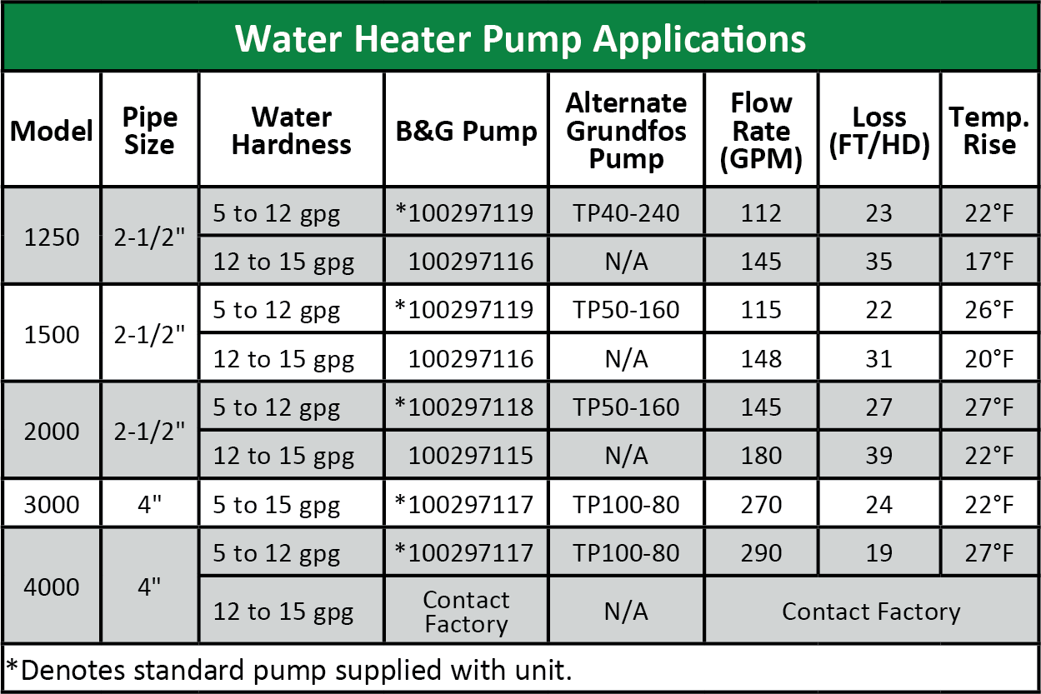
Piping
XP ^{PLUS} Water Chemistry & Pump Info
Water Chemistry
Notes:
Water chemistry is very important. With this vital information found in our installation manuals, you can make important decisions. The forced circulation design of the water tube can deliver lime scale free operation. Logically though, the customer can have spectacularly hard water that would be damaging to any water heater.
This information tells us what we need and how to operation the water heater based on typical water chemistry. If the water chemistry is outside the range of 5-15 grains, then action would need to be taken to bring the water into proportional quality.

Slide 18
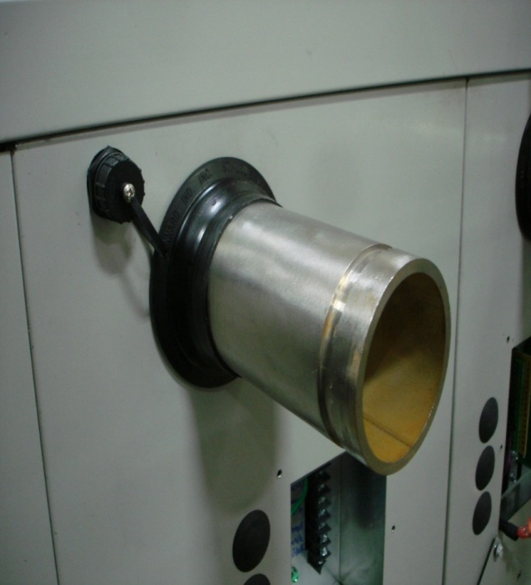
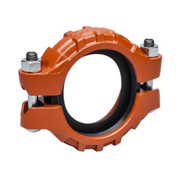
XP ^{PLUS} Water Piping
2 ½” water connections for 1250-2000 models
4” water connections for 3000 & 4000 models
Connections are made with Victaulic adapters

Slide 19
XP ^{PLUS} Piping – Single Unit
Weight support of circulating pump may be needed

Slide 20
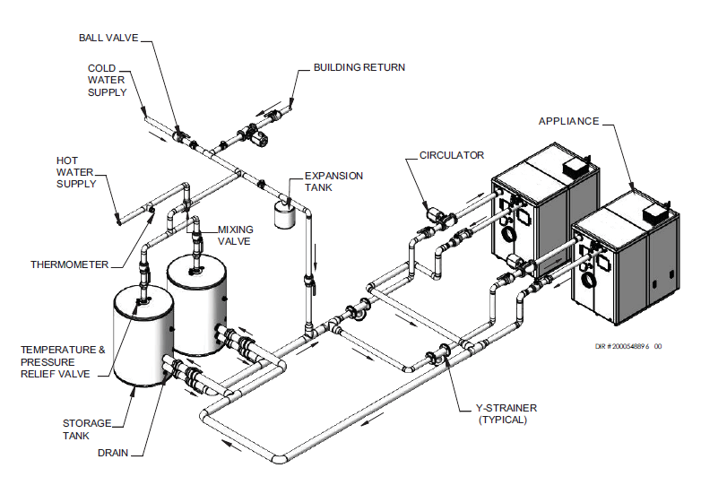
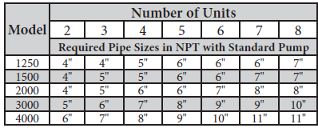
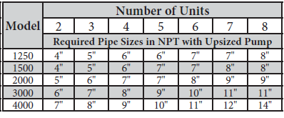
XP ^{PLUS} Piping – Multiple Units
Piping
Standard Pump
Upsized Pump

Slide 21
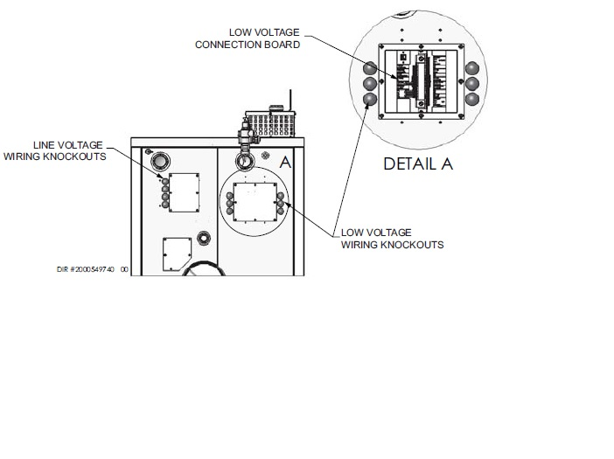
XP ^{PLUS} Electrical Requirements
For 1250 & 1500 models connect 120V electrical supply
For 2000 & 3000 models connect 208V 3 phase electrical supply
For 4000 models connect 480V 3 phase electrical supply
Model | Unit Amp Draw | Pump Amp Draw
1250 | 9.9 | 11.2
1500 | 7.8 | 11.2
2000 | 1.3 | 9.6
3000 | 2 | 13.4
4000 | 2.3 | 6.1

Slide 22
XP ^{PLUS} Wiring 1250- 1500 Models
120V 1ph
G
L
N
* Relay (Field Supplied)
*Service switches recommended
(Not illustrated)
*Ground Not
Illustrated
L
N
1HP 115V 1ph

Slide 23
XP ^{PLUS} Wiring 2000 & 3000 Models
Wiring
208V 3ph
G
L1
L2
*Definite Purpose Contactor/
Relay (Field Supplied)
L3
N
*Service switches recommended
(Not illustrated)
L1
L2
L3

Slide 24
XP ^{PLUS} Wiring 4000 Model
480V 3ph
G
L1
*Definite Purpose Contactor/
Relay (Field Supplied)
L2
L3
N
*Service switches recommended
(Not illustrated)
L1
L2
L3

Slide 25
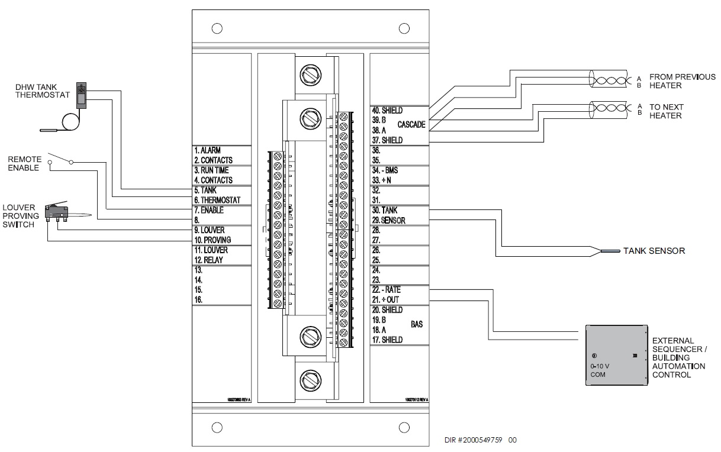
XP ^{PLUS} Wiring – Low Voltage Connections

Slide 26
XP ^{PLUS} Gas Supply Requirements
Gas lines sized per the National Fuel Gas Code
Natural gas requirements are 14” w.c. maximum to 4” w.c. minimum
Propane gas requirements are 14” w.c. maximum to 8” w.c minimum
Unit | Inlet Connection Size
1250 | 1 ½”
1500 | 1 ½”
2000 | 1 ½”
3000 | 2”
4000 | 2 ½”

Slide 27
XP ^{PLUS} Gas Supply Piping

Slide 28
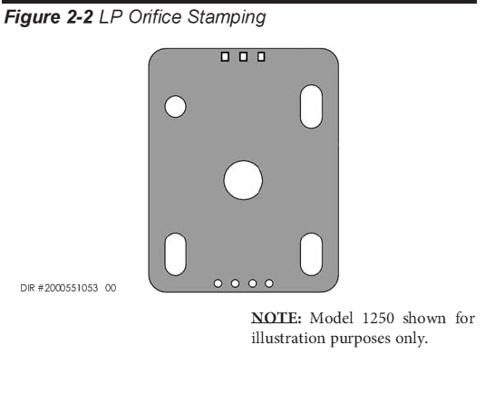
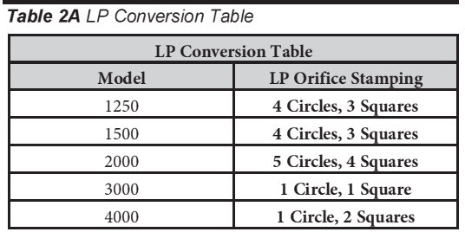
XP ^{PLUS} LP Gas Conversion
Units may be converted to propane with the addition of a propane orifice and an air orifice plate for 3000 & 4000 models. Kits available

Slide 29
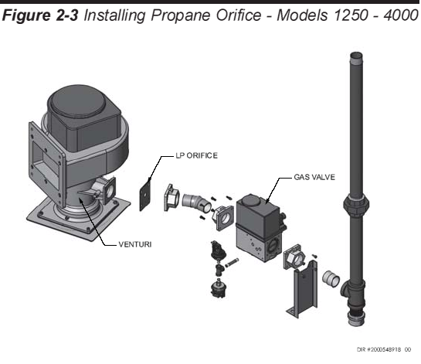
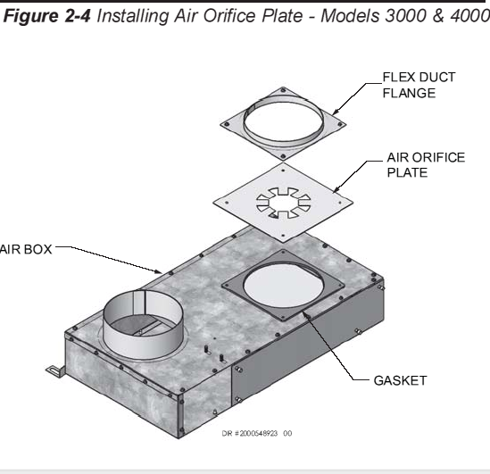
XP ^{PLUS} LP Gas Conversion

Slide 30
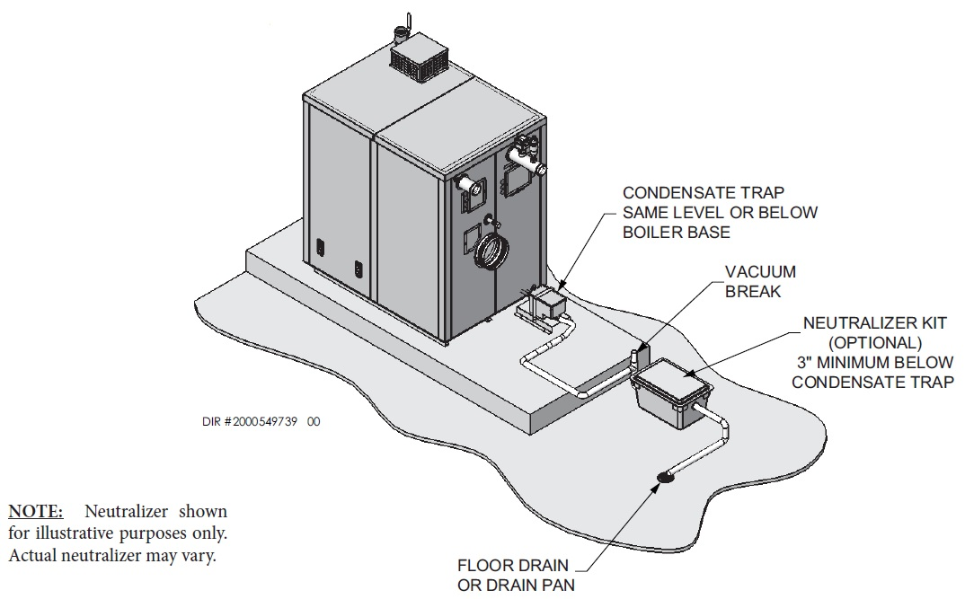
XP ^{PLUS} Condensate Removal

Slide 31
XP ^{PLUS} Controls
Controls
  Built-In Cascading Sequencer for up to 8 Water Heaters
Leader
Member 1
Member 2
Member 3
Member 4
Member 5
Member 6
Member 7
Notes:
Cascade Sequencing will allow up to eight water heaters to communicate and work together as a team. One water heater is assigned as the Leader. The Leader can be daisy-chained together with up to seven “Member” water heaters. The Leader will guide the Member water heaters to deliver the most efficiency operation of multiple units. This is a valuable feature for large commercial applications where multiple water heaters are the norm. Extra note, each day the Leader water heater will assign “First ON” to a different water heater. This rotation of “First ON” puts equal use on the appliances over the course of the season.

Slide 32
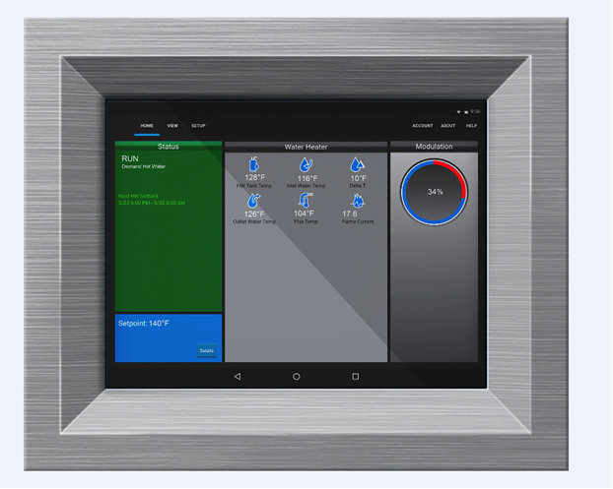
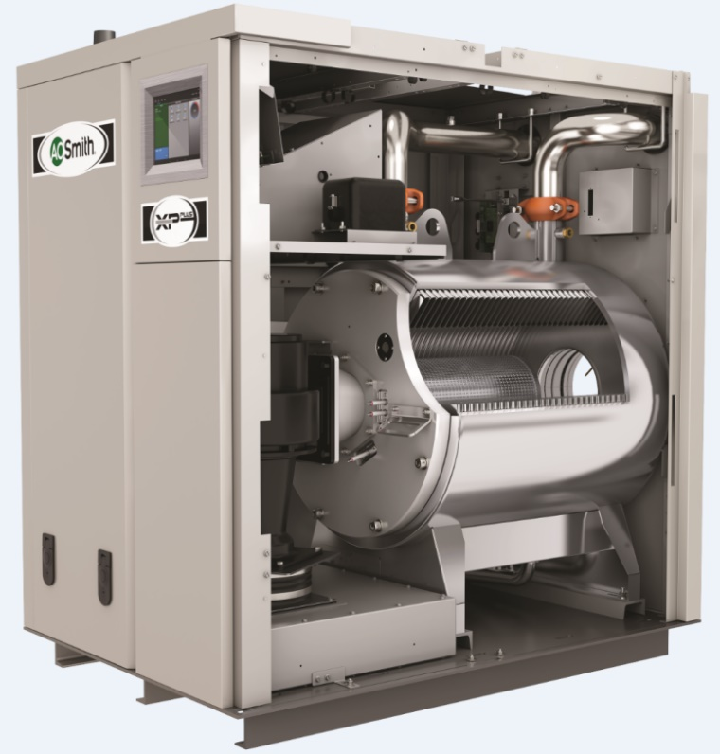
XP ^{PLUS} Controls
Display
8” Touch screen display

Slide 33
Questions?

