Slide 1
Standard Electric
No Hot Water

Slide 2
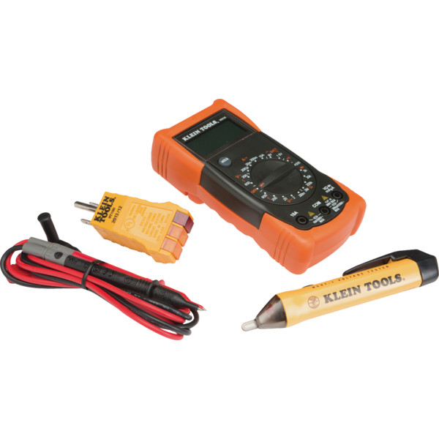
ELECTRICAL TEST KIT
PART#: 109952

Slide 3
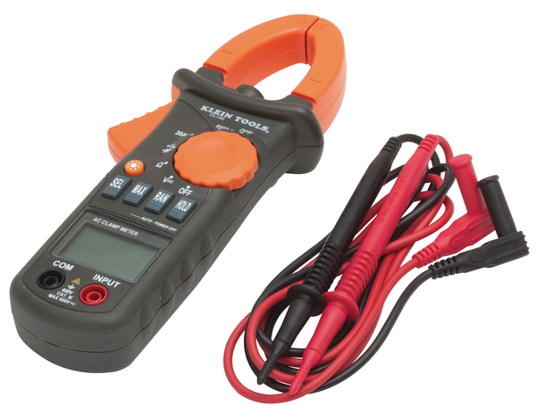
Klein® Tools 600 Amp AC Clamp Meter
PART#: 504253

Slide 4
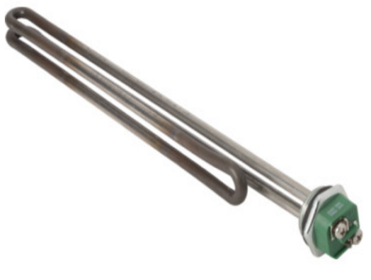
Incoloy Water Heater Element 3800/240
PART#: 754234

Slide 5
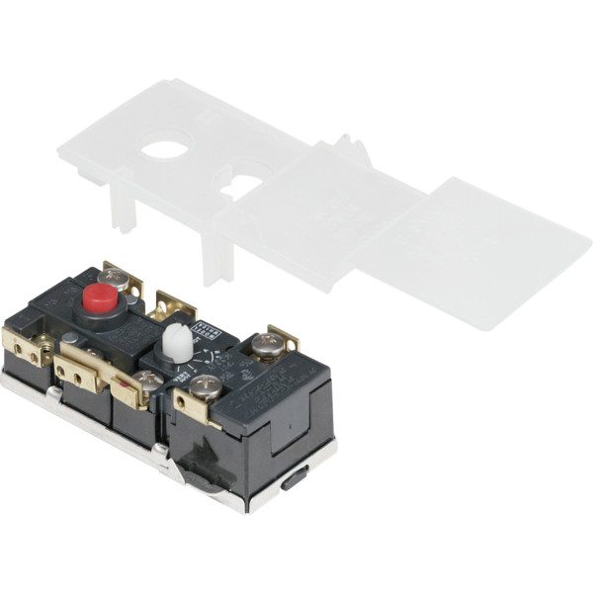
Apcom® Electric Water Heater Thermostat Double Throw
Part#: 206800

Slide 6
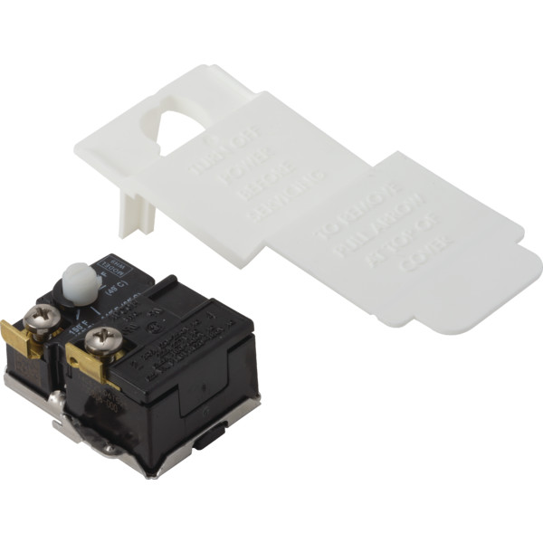
Apcom® Electric Water Heater Thermostat Single Throw
Part #: 206830

Slide 7
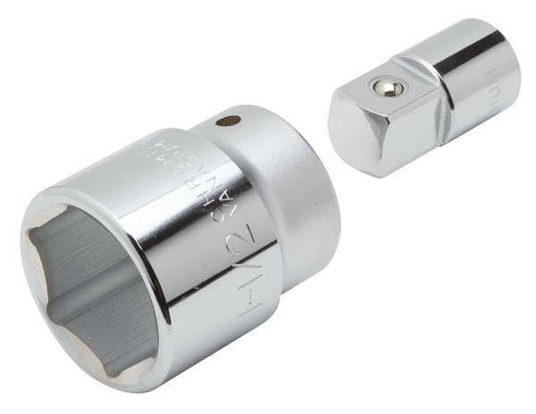
Water Heater Element Socket
Part #: 500738

Slide 8
Standard Electric
Not Enough Hot Water

Slide 9
ELECTRICAL TEST KIT
PART#: 109952

Slide 10
Klein® Tools 600 Amp AC Clamp Meter
PART#: 504253

Slide 11
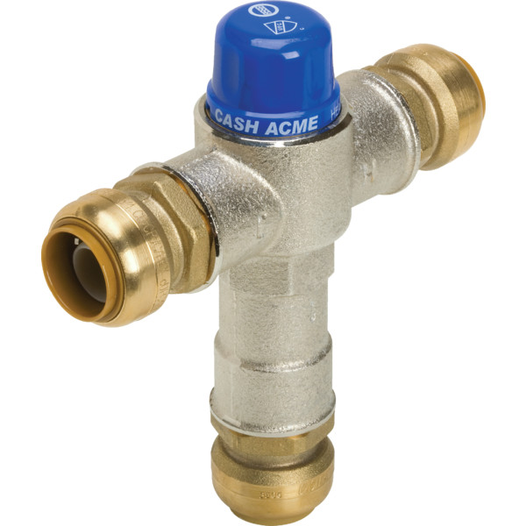
SharkBite® Thermostatic Mixing Valve
PART#: 640327

Slide 12
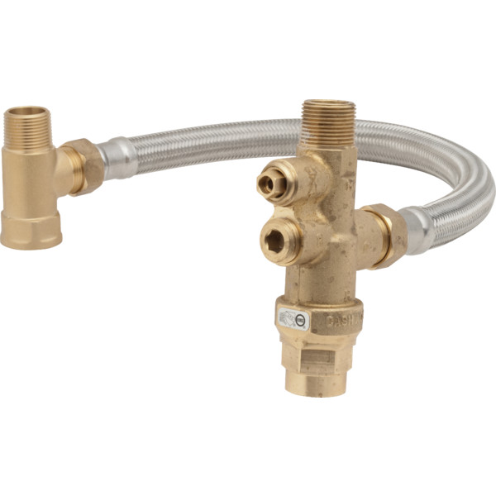
Mixing Valves
PART#: 400559

Slide 13
Incoloy Water Heater Element 3800/240
PART#: 754234

Slide 14
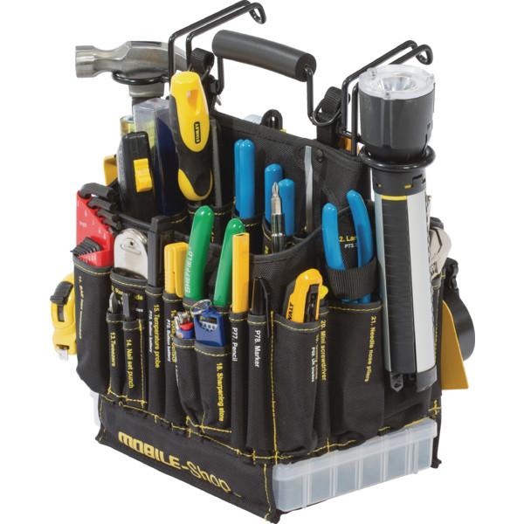
Mobile-Shop Tool Service Bag
Part #: 129481

