Slide 1

Accounting 101

Slide 2

Why do so many small businesses fail?
90% of small businesses fail due to poor financial management, lack of internal controls, and inadequate planning.
Notes:
Why do so many small businesses fail? Poor cash flow or financial management, lack of internal controls, poor planning and lack of understanding by the owner of what the numbers represent or the inability to even produce a financial statement that has any meaning is often at the center of small business failure.

Slide 3

Why do you need to understand and create accurate financial reports for your business?
Notes:
Why do you need to understand and create accurate financial reports for your business?
Accurate Financial reports :
1. Help you make informed business decisions
2. Allow you to recognize negative and positive trends quickly
3. Protect you against fraud
4. Allow you to intelligently communicate and work with vendors,
banks and investors
5. Save you money
6. Keep you out of trouble with the local, state and federal tax
authorities by helping you report accurate tax information
7. Can prevent your business from failing
In this session we will focus our attention on financial accounting/reports and what you need to know to make this information accurate and useful.

Slide 4
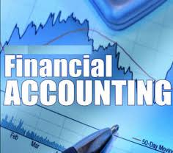
Financial Accounting it primarily concerned with the recording and reporting of economic data and activities for a business.
Notes:
Financial Accounting it primarily concerned with the recording and reporting of economic data and activities for a business.
In its most basic form, accounting is a system for keeping score.
It allows you to measure the progress and history of your business and compare it to your goals.
It allows you to communicate your success with others like the bank, investors, partners and your team.

Slide 5

Bookkeeping
Notes:
Bookkeeping is the record-keeping portion of accounting.
It is the gathering, collecting and recording of the daily financial transactions of a business., the Process for turning all the financial transactions into financial statements.

Slide 6
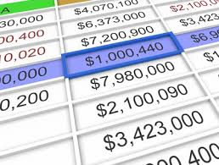
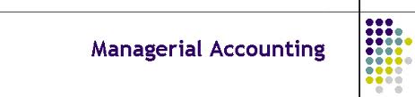
Managerial Accounting uses both the financial
data and estimated data to run
the day to day operations
and in planning future activities.
Notes:
Managerial accounting is future oriented. It uses both the financial data and estimated data (budgets) to run the day to day operations and in planning future activities.
Managerial Accounting places emphasis on making the right decisions today to ensure successful future performance
It includes preparation of reports for internal decision making and it depends on historical data obtained as part of the bookkeeping function of accounting.
Although we will not be talking about this today, it is important to recognize that understanding financial accounting will provide the segue to making intelligent financial management decision in the future. We will be discussing Managerial Accounting in another session.

Slide 7

The Bookkeeping Process
Cash vs. Accrual Accounting

Slide 8

Cash-basis Accounting
A method of accounting based on cash flow.
This method is really only accurate and effective with businesses that have no Accounts Receivable, Accounts Payable or Inventory.
Notes:
Cash basis accounting is a method of accounting based on cash flow.
Expenses are reported when you lay out the cash.
Income is reported only when payment is received.
(Checks and credit cards are same as cash)
This method provides a clearer picture of cash flow but does not do a good job
of matching income to expenses incurred to earn that income.
Cash Basis Accounting is really only accurate and effective with businesses that have no Accounts receivable, accounts payable or inventory.

Slide 9
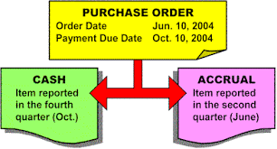
Accrual-basis Accounting
A method of accounting based on when a transaction occurs, regardless of whether cash changes hands.
Notes:
Accrual basis accounting is a method of accounting based on when a transaction occurs, regardless of whether cash changes hands.
Using this method, income is counted when the services have been performed and invoiced.
Expenses are counted when the goods and services are received or expenses incurred even if no payment has been made.
Accrual accounting prevents a skewed picture of true profit or loss because expenses are matched to the income being received.

Slide 10
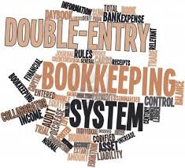
The Bookkeeping Process
Notes:
So what should your bookkeeper be doing to keep your financial record straight?
The bookkeeper should:
Capture transactions with customers and vendors
Collect and file source documents like invoices, payroll records…
Record transactions into the General Journal
Conduct end of the month procedures and close outs
Prepare monthly, end of period reports
Review reports for accuracy
Close the books

Slide 11
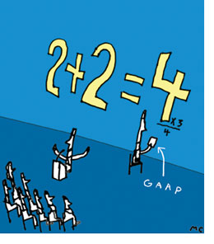
Reporting Standards
Uniform standards are important. These rules known as the Generally Accepted Accounting Principles are universal. They are the “rules” of the accounting world.
Notes:
Uniform standards are important. These standards are known as Generally Accepted Accounting Principles and they are universal. They are the “rules” of the accounting world.
These rules provide a:
Standardized method of measuring profits and reporting financial results
Terminology that carries the same meaning no matter how it is used
And Allow for the comparison of financial performance and conditions in like businesses.

Slide 12
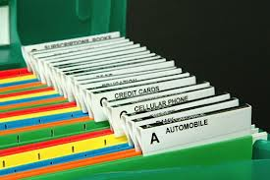
Chart of Accounts
Notes:
It all starts with a Chart of Accounts.
This is basically an index to all the places you file financial information in your accounting system
It allows you to track specific activities within your business
It is the codebook for your accounting system
- catalogs all sales, expenses, assets, liabilities and equity
A chart of accounts can be compared to an individual mailbox at the post office. If the mail goes in the wrong slot or is delayed problems occur in your business.
The chart of accounts is separated into sections:
Balance Sheet items – assets, liabilities and owners equity
Income
Cost of Goods sold
Operating Expenses
Other income
Other expenses

Slide 13

Balance Sheet –
Statement of Financial Position
The balance sheet provides the truest picture of the long-term health of your business.
Notes:
The financial position of the business at a particular point in time.
It shows the assets (what the business owns)
It shows the liabilities (How much you owe)
It shows the net worth (what’s let over, equity)
The balance sheet provides the truest picture of the long-term health of your business because it is a reflection of your business from day one .

Slide 14

Notes:
Anything owned by the company, whether paid in full or not. Assets are always at the top of the statement and can be identified in three categories:
Current Assets
Fixed Assets
Other Assets

Slide 15
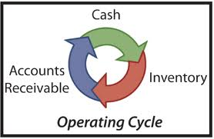
Current Assets
Assets that are either cash or can be converted to cash in less than one year.
Notes:
Current assets are either cash or can be converted to cash in less than one year.
Examples are:
Cash on hand in the bank
Accounts Receivable
Inventory
Prepaid Expenses

Slide 16

Fixed Assets
Assets that can not easily be turned into cash and typically depreciate over time (with the exception of land)
Notes:
Fixed assets can not be easily turned into cash and typically depreciate over time (with the exception of land).
Examples of Fixed Assets are:
Trucks
Machinery and equipment
Furniture and fixtures
Real estate
Office and warehouse facility if owned

Slide 17

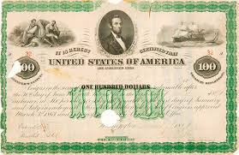


Other Assets
Other Assets include all long term investments and intangible assets which may be assigned a value for determining the total sale price of a business.
Notes:
Other Assets are neither current nor fixed but have value.
Other assets include all long term investments and intangible assets which may be assigned a value for determining the total sale price of a business.
Examples of other assets:
Cash surrender on officer’s life insurance
Intangibles (Good Will, Patents, Trademarks)
Securities (Stocks, Bonds, Mortgages)

Slide 18
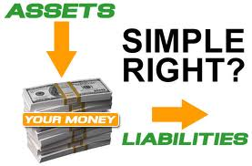
Liabilities
Are the amounts the business owes to creditors.
Notes:
Liabilities are the amounts the business owed to creditors.
Liabilities can be identified in two categories:
Current liabilities
Long Term Liabilities

Slide 19

Current Liabilities
Are debts that the company will pay off in one year or less.
Notes:
Current liabilities are the debts that the company will pay off in one year or less.
Examples are:
Accounts Payable
Current portion of notes payable
Any accrued taxes or wages

Slide 20

Long Term Liabilities
Are debts the company owes that will not be repaid within the next 12 months.
Notes:
Lon term liabilities are debts the company owes that will nor be repaid within the next 12 twelves months.
Examples are:
Loans for Vehicles and Equipment
Property
Buildings
Starting capital

Slide 21
Understanding Transactions
 | Balance Sheet Accounts
 | Assets |  |  |  | Liabilities & Owner's Equity
Debit |  |  | Credit |  | Debit |  |  | Credit
Increases |  |  | Decreases |  | Decreases |  |  | Increases

Slide 22
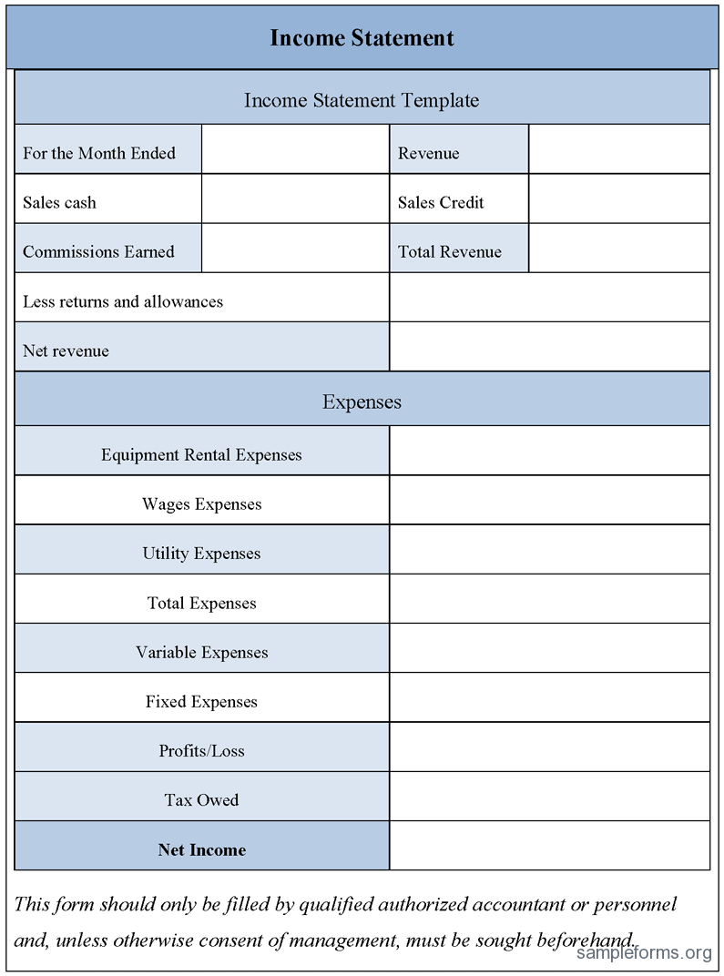
Income Statement
Notes:
An income statement is simply the summary of the revenues, costs and expenses of a company that are recognized during an accounting period.
Also known as the Profit and Loss Statement, Operating Statement or the Earnings Report
If done accurately, it is this summary of revenues and expenses that determines profits or losses
Unlike the balance sheet, an income statement reflects the results of a business over a period of time

Slide 23
Every business transaction affects at least two accounts.
Assets= Liabilities + Equity
Notes:
When dollars are recorded in one account they must be accounted for in another account so that the accounting equation stays in balance.

Slide 24
5 Categories of an Income Statement
Income, Revenue, Sales
Cost of Goods Sold (Direct Costs)
Expenses (Indirect Costs)
Other Income
Other Expenses
Notes:
There are five accounting categories on an income statement.
Income
Cost of goods
Operating expenses
Other income
Other expenses.
Let’s take a look at each and see how they affect the income statement as a whole.

Slide 25


Income, Revenues or Sales
Notes:
Income, revenues or sales are all different words that mean “The earnings of a business”
Although there may be different forms of income, the first section of an income statement represents sales directly related to the offerings of services or products provided by the business.

Slide 26

Cost of Goods Sold – Direct Costs
Notes:
Cost of Goods Sold refer to the total cost for the products and labor used to provide service or products to a customer. These are variable expenses that are directly related to sales. In our industry the most common COGS are:
- Subcontractors
- Permits
- Field Labor
- Equipment Rental
Credit Card Fees
- Materials
- Commissions
- Fuel (service vehicles only)

Slide 27
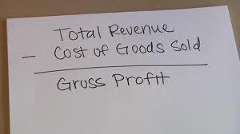
Gross Profit/Gross Margin
Formula: Sales – COGS = Gross Profit
Formula: Gross Profit/Sales x 100 = Gross Profit Margin
Income 100,000 100%
- Materials - 15,000 15%
COGS - Labor - 25,000 25%
- Permits - 4,000 4%
- Subcontractor- 2,000 2%
Total 46,000 46%
Gross Profit 54,000 54%
Notes:
The purpose of creating financial statements is to see how the company is progressing, if the company is charging correctly, spending within its means and making a profit. Profit is important because without it, a company would cease to exist.
There are different types of profit but those you should be most concerned with are gross profit and net profit.
Gross profit is the amount left after all costs directly associated with a sale have been calculated or after all COGS have been deducted.

Slide 28
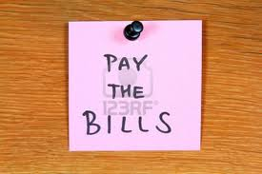
Expenses - Indirect Costs, SG&A Expenses
Notes:
Operating expenses are costs that do not change over the short term in response to the volume of company sales. Also referred to as fixed costs, these expenses do not go away if the company fails to sells their products or services.
Items included would be any expense not directly related to the sale such as:
Rent
Telephone
Admin Labor and Salaries
Insurances
Marketing
Utilities
Current support expenses not allocated to sales or production

Slide 29
Net Operating Profit
Formula: Gross Profit – SG&A Expenses = Net Operating Income
(SG&A – Selling, General and Administrative Expenses)
- Income 100,000 100%
- COGS 46,000 46%
- Gross Profit 54,000 54%
- Expenses 38,000 38%
- Net Op Profit 16,000 16%
Notes:
Net operating profit is the amount of income remaining after all cogs and operating expenses have been calculated.

Slide 30
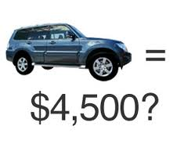

Other Income & Other Expenses
Notes:
Other income and other expenses occur when an asset is sold or destroyed or charges are incurred that do not relate directly to sales of merchandise, services or products.
Examples of Income – interest income or non-operating income
example: money earned from sale of asset
interest earned from investments, bank
earned rent
Examples of expenses – interest expense or non-operating expense
example: interest paid on a financing activity
loss incurred in disposal of an asset

Slide 31

Net Profit Before Taxes
Formula: Gross Profit – Expenses – Other Expenses +Other Income = Net Profit
Formula: Net Profit/Sales x 100 = Net Profit Margin
This represents the profits of the company before final adjustments are made for federal and state taxes.
- Sales 100,000 100%
- COGS 46,000 46%
- Gross Profit 54,000 54%
- Expenses 38,000 38%
- Net Op Profit 16,000 16%
- Other Income 1,000
- Other Expense 2,000
- Net Profit 15,000 15%
Notes:
Net profit is the result of all sales minus all costs.
The most common question I receive from my clients is how can my income statement show I made money when I have no money in the bank? What am I doing wrong?
The answer is reflected in your balance sheet. An income statement does not take into account any payments you may be making such as loans, mortgages, dividend payments. Many businesses also do not account for depreciation monthly but instead annually. All of these things change the profitability number that shows on the income statement. It is important to know how much money is needed monthly to pay those items from the balance sheet to be sure you do not overspend what you think is profit.
This is why a statement of cash flows is so important. Lets look at statement of cash flow.

Slide 32

Statement of Cash Flows
Notes:
A statement of cash flows is a presentation of a company’s cash receipts and payments over a period of time.
It shows the movement of cash through a business
It is a summary of cash sources (receipts) cash uses (payments) for a certain period of time.
It provides information on the liquidity and financial flexibility of a business.
It explains the change of cash and cash equivalents during a period. (Investments like treasury bills and money market funds)
It allows outsiders to see a company’s ability to generate future cash, meet debt obligations and pay dividends
And it identifies company’s need for future external financing

Slide 33

Classifications for Statement of Cash Flows
Operating Activities
Investing Activities
Financing Activities

Slide 34

Operating activities
Cash received from:
Sale of goods or services
Collections of receivables
Interest on loans and bonds
Dividends on equity securities
Insurance/Lawsuit settlements
Refunds from suppliers
Cash paid to:
Acquisition of materials
Creditors for interest
Employee compensation
Taxes, fees, fines, penalties
Customer refunds
Lawsuit settlements
Charitable contributions

Slide 35

Investing Activities
Cash received from:
Sale of property, plant,
equipment and other
productive assets
Sales of a business unit
Collections of principal on debt
instruments of other company
Sale of loans
Cash paid to:
Acquire property, plant,
equipment and other
productive assets
Acquire another business
Make loans to and/or purchase
loans from another company
Acquire debt or equity
investments in other
companies

Slide 36

Financing Activities
Cash received from:
Issuing equity such as stock
Issuing bonds, mortgages, notes
and other forms of short-
term or long-term borrowing
Cash paid to:
Owners of the company in the
form of dividends or other
distributions
Repayment of amounts
borrowed on short-term and
long-term debt

Slide 37

Cash flow is the barometer of a business!
Notes:
Cash flow issues are symptoms to deeper problems
Too much inventory/other non liquid assets (turnover too slow)
Receivables too high – not collecting quickly enough
Inadequate gross profit percentage – pricing & mark up issues
Expenses out of control – too many employees, too much
inventory, sales are down with no cut in expenses
Owner compensation – bleeding the profits from the busines

Slide 38

Managing a Profitable Company
Notes:
The purpose of financial statements is to measure the performance of a business.
It is common for a profit and loss or Income statement to represent a month, a quarter or a year. In an Income statement, sales flow in and expenses flow out, resulting in either a positive or negative profit.
A balance sheet shows the relationship between assets, liabilities and owner’s equity. It is the truest picture of the company on any specific date.
A cash flow statement reports the movement of money into or out of the cash account over a specific period of time. It contains information from both the Balance Sheet and the Income statement. Cash is needed to meet daily business obligations and having money in the bank is essential because you can not pay day to day expenses with money that has yet to be collected. Understanding your cash flow is a must!
Please join us for our next session about how to use the information you gather in your financial statements to make sound financial management decisions.

